Slide 1

rEASON PROJECT
Rural Emergent Alternative Surgical Opioid Non-use
Closing the Door on Surgery as a Gateway to Persistent Use of Opioids
Module 6: Multimodal Analgesia; Concepts & Implementation: NSAIDS & Alternatives
© 2021 Cornerstone Whole Healthcare Organization. All rights reserved.

Slide 2
about this course:
Goal: Educate stakeholders on the role of surgery as a gateway to persistent opioid use.
Means: Seven modules to promote understanding how and why surgery may lead to opioid use disorder.
Outcomes:
Providers will be able to educate patients about their options for surgical pain management.
Advocate for safe and effective opioid-free pain treatment and follow-up.
Achieve prevention of opioid use disorder.

Slide 3
01
Surgery as a Gateway to Persistent Opioid Use; Defining the problem
02
Opioids; From Friend to Foe
03
Opioid Induced Hyperalgesia
Curriculum Modules
Adolescents/Young Adults as a uniquely Susceptible Group
04
05
Multimodal analgesia; concept and implementation: Regional Anesthesia
06
Multimodal analgesia; concept and implementation: NSAIDs
Developing a Pain Management Plan: Responsible Follow-up& Transition of Care From Surgery
07

Slide 4
Modul 6: Multimodal analgesia; concept and implementation: NSAID Module Objectives
Upon completion of this course, the learner will be able to:
Understand the problem of surgery as a gateway to persistent opioid use
Understand NSAIDs as a key component of Multimodal Analgesia
Discuss the prevalence of opioid overuse as a complication of surgery
Understand post operative implication of NSAID use
Discuss opioid sparing alternatives to opioid monotherapy
Discuss multimodal, multidisciplinary pain management planning

Slide 5
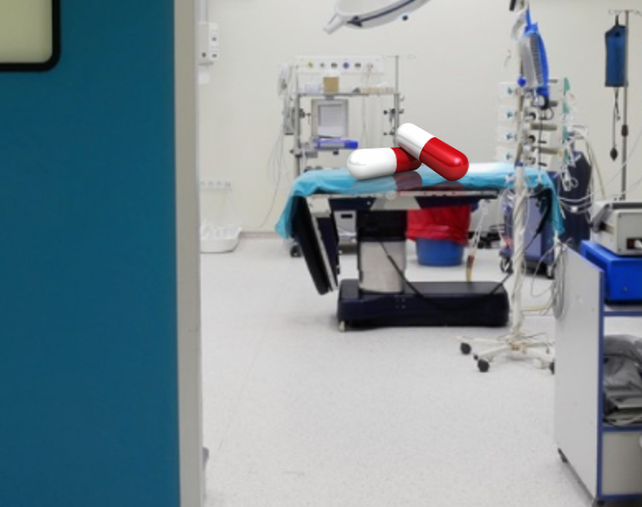
PURPOSE:
Closing a Silent Gateway to Opioid Use & Dependence

Slide 6
Review the Problem:
Surgery has been a long-ignored gateway to persistent opioid use, dependence and addiction
Surgery is frequently the first-time patients are exposed to opioids
The role of opioids in treating postsurgical pain has been overlooked as a contributing factor to the opioid epidemic
Nearly 4.7-12% of surgical patients in 2017 continued to take opioids three to six months following surgery with as high as 17% for patients undergoing certain surgeries.
Clinicians treating surgical pain need the tools and resources to make evidence-based prescribing decisions that will adequately treat patients’ pain while minimizing opioid risks

Slide 7
Movement away from perioperative opioid use is a necessary paradigm shift
Perioperative opioid prescription is an independent risk factor for chronic opioid use
Opioids should be reserved as rescue analgesia
Perioperative opioid sparing strategies endorse regional anesthesia & non-opioid pain management
Opioid free analgesia combines various opioid sparing strategies to eliminate opioid usage.

Slide 8

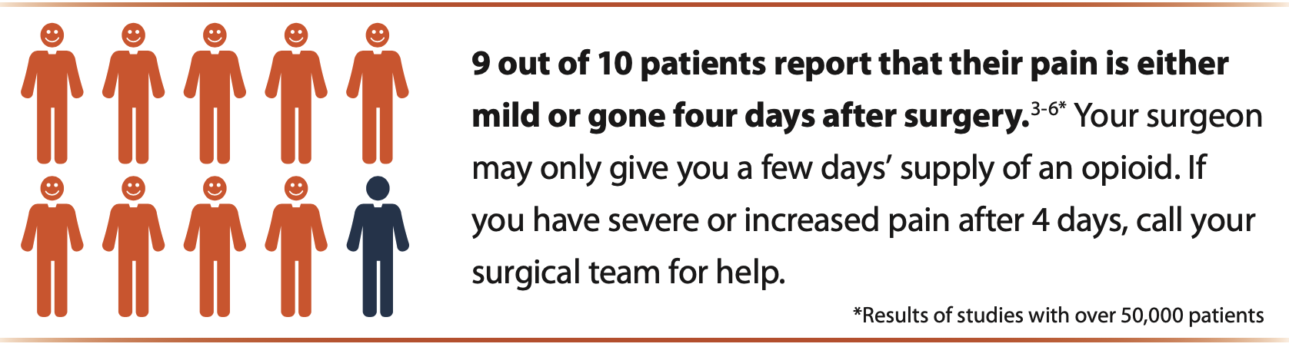
Post Surgical Pain: American College of Surgeons
What are their recommendations?

Slide 9
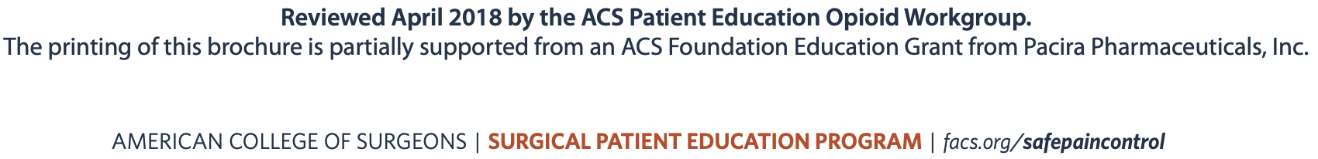
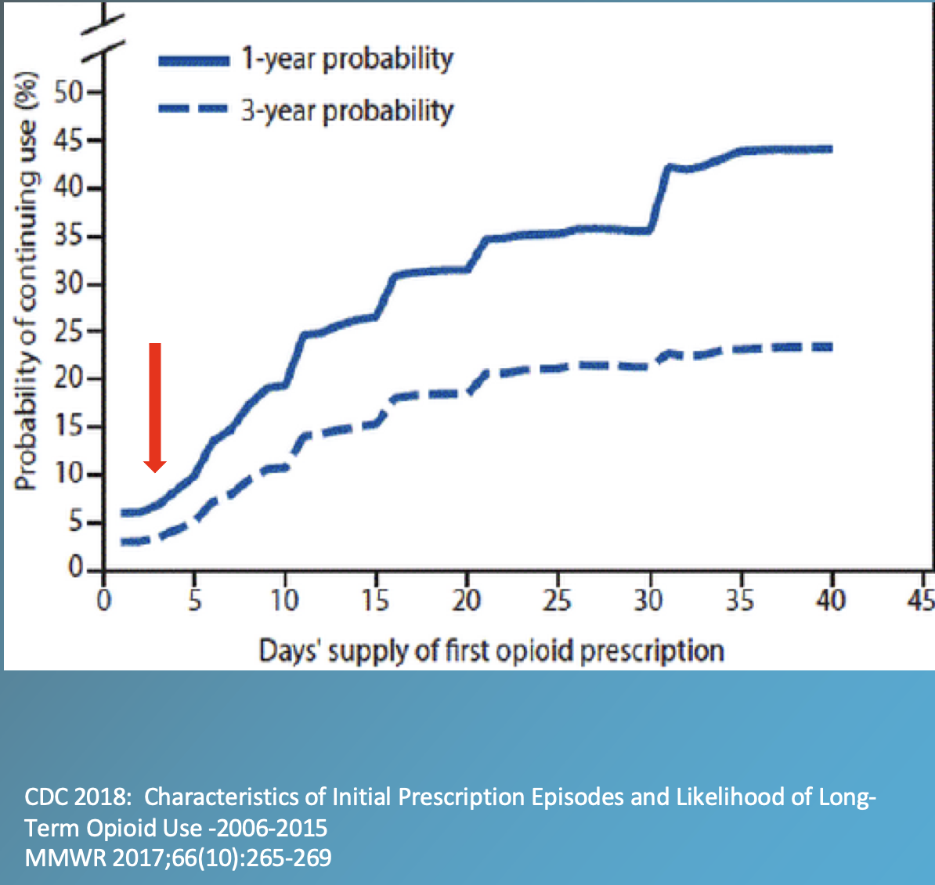
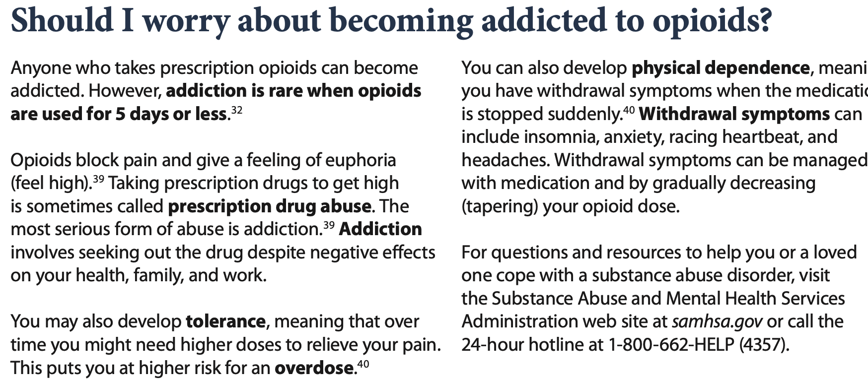
Opioids: American College of Surgeons

Slide 10
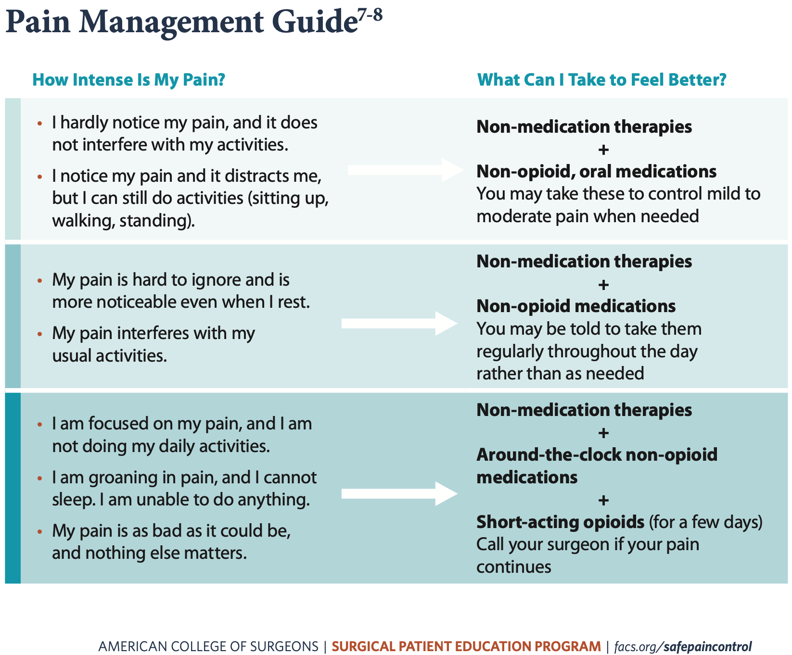
NSAIDs: American College of Surgeons
What are the recommendations?

Slide 11
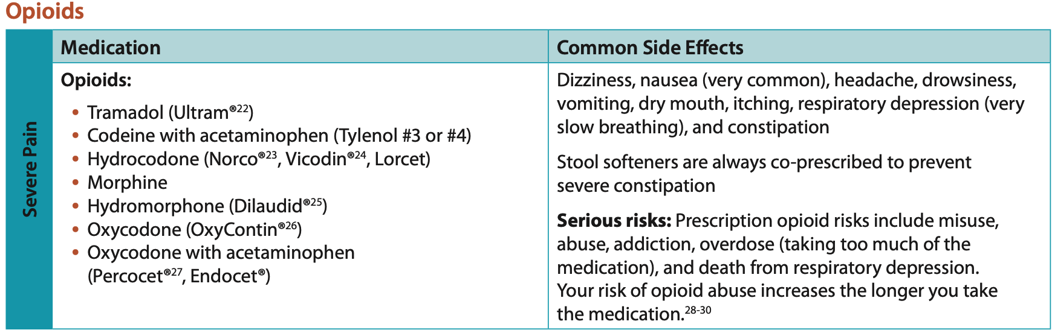
Opioids?
What are the recommendations?

Slide 12
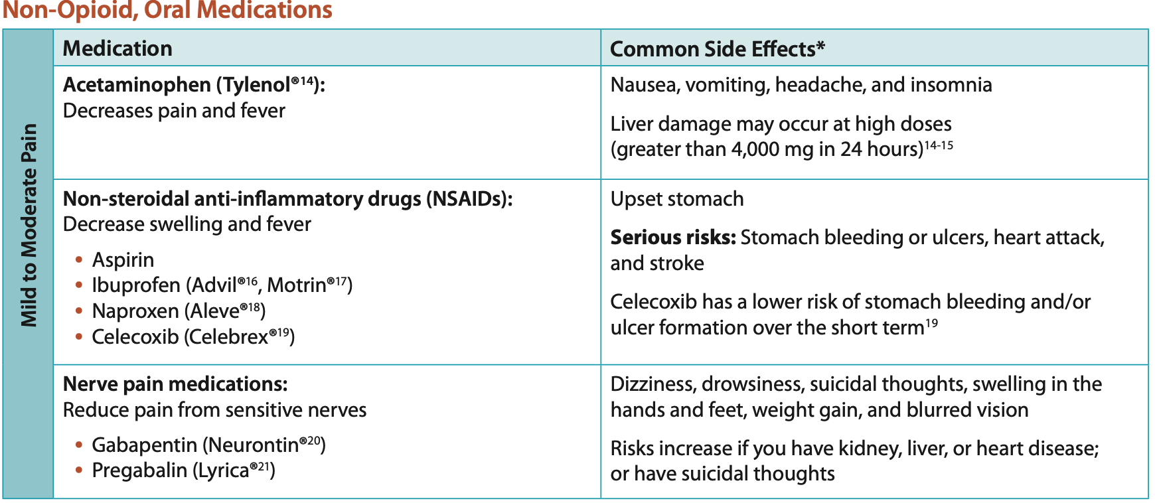
NSAIDs:
American College of Surgeon Recommendations

Slide 13
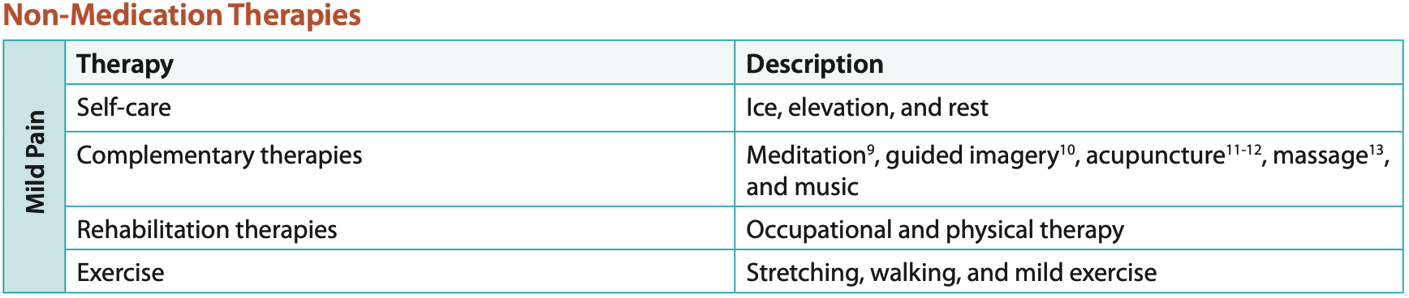
Non-Medications?
What are the recommendations?
Vibration Therapy: when combined with cool / heat demonstrates high efficacy pain reduction in joint replacement.
Buzzy, Vibracool.

Slide 14
Review of NSAIDs

Slide 15
NSAIDs: General
Common use: treat inflammation, pain, and fever
Mechanism of Action:
Decrease prostaglandin synthesis via cyclooxygenase (COX) enzyme blockade
2 major isoforms of COX (COX-1 and COX-2) are inhibited by nonselective NSAIDs. COX-2 is also inhibited by selective NSAIDs
  nonselective NSAIDs inhibit platelet aggregation through inhibition of COX-1 and the thromboxane A2 (TXA2 ) pathway
  COX-2 inhibitors have minimal antiplatelet effects because they do not affect the TXA2 pathway because prostaglandin-mediated gastroprotection occurs through the COX-1 enzyme

Slide 16
NSAIDs: Class Adverse Effects
GI
Cardiovascular
Hepatic
Renal
Hematologic
Central nervous, and respiratory
with special considerations for children, pregnant or lactating women.

Slide 17
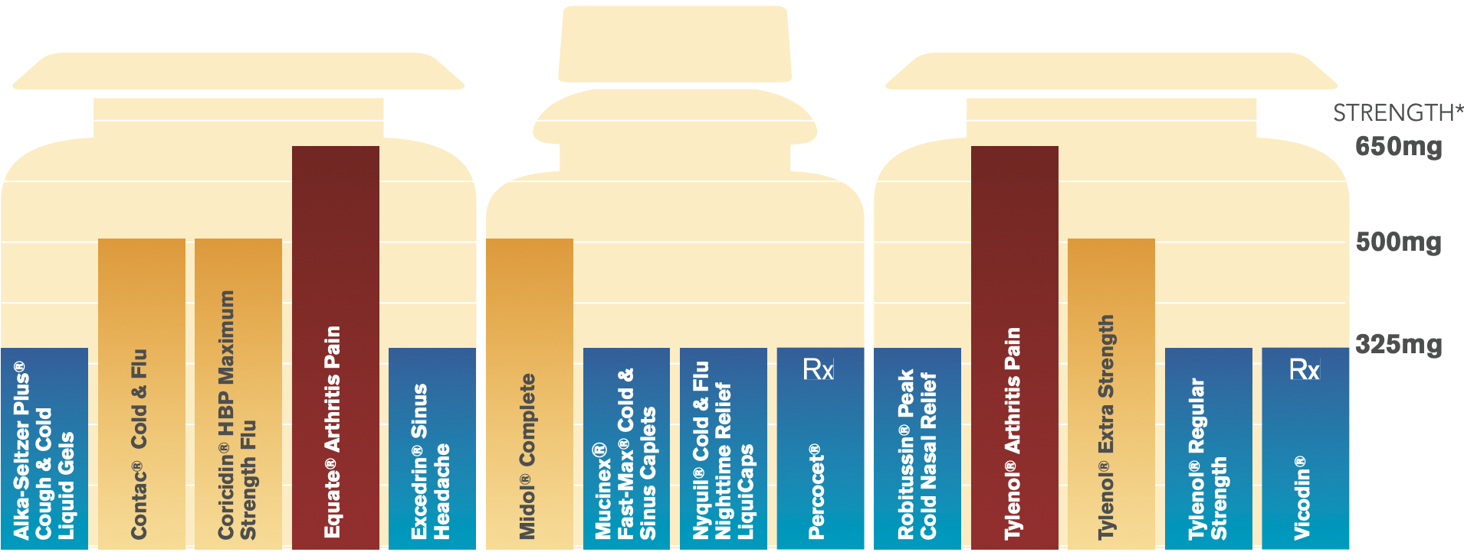
NSAIDs: acetaminophen is a powerful drug
Exceeding 4000mg / Day may result in Liver Damage
In >600 over-the-counter & prescription medicines
50 Million Americans use every week
Acetaminophen & your liver
Common medicines containing acetaminophen

Slide 18
NSAIDs: Integral to Pain Optimization Plan
American Society of Anesthesia Recommendations for postoperative multimodal pain management regimen:
acetaminophen
COX-2 selective NSAIDs (COXIBs), nonselective NSAIDs, and calcium channel α-2-δ antagonists (gabapentin and pregabalin)
unless contraindicated, patients should receive an around-the-clock regimen of NSAIDs, COXIBs, or acetaminophen
dosing regimens should be administered to optimize efficacy while minimizing the risk of adverse events; and
the choice of medication, dose, route, and duration of therapy should be individualized.

Slide 19
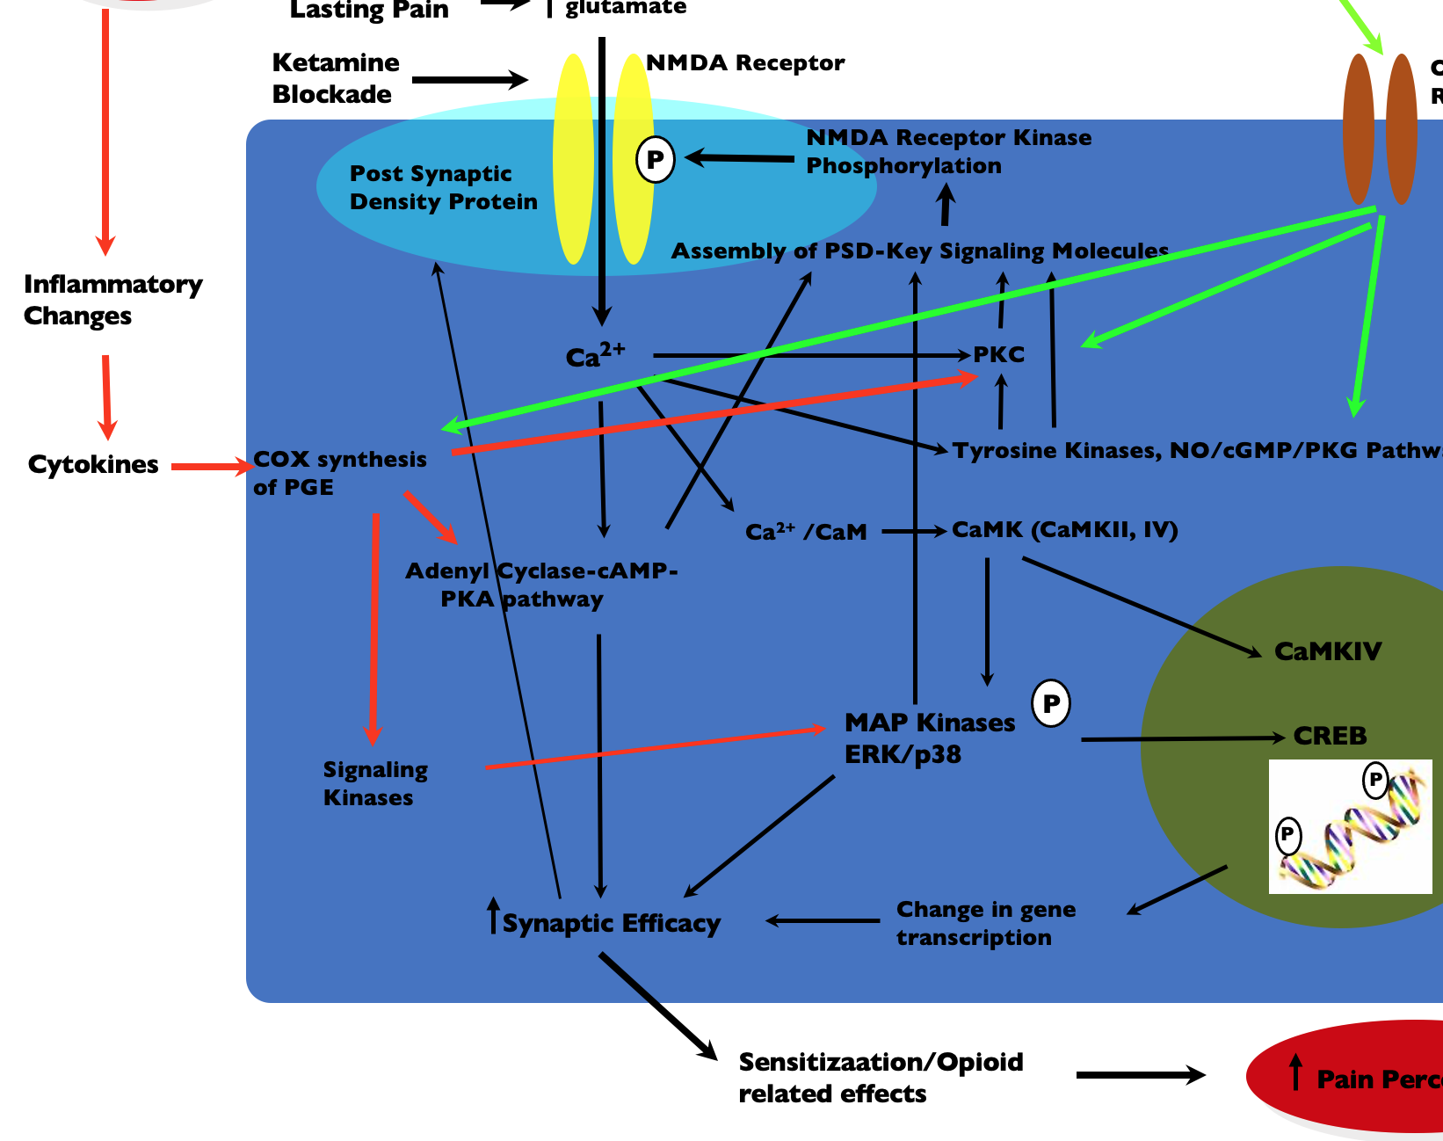
Pain Pathways are very complex!!
Can opioids possibly block all this?
Notes:
Do you think one drug is going to take care of all that?

Slide 20
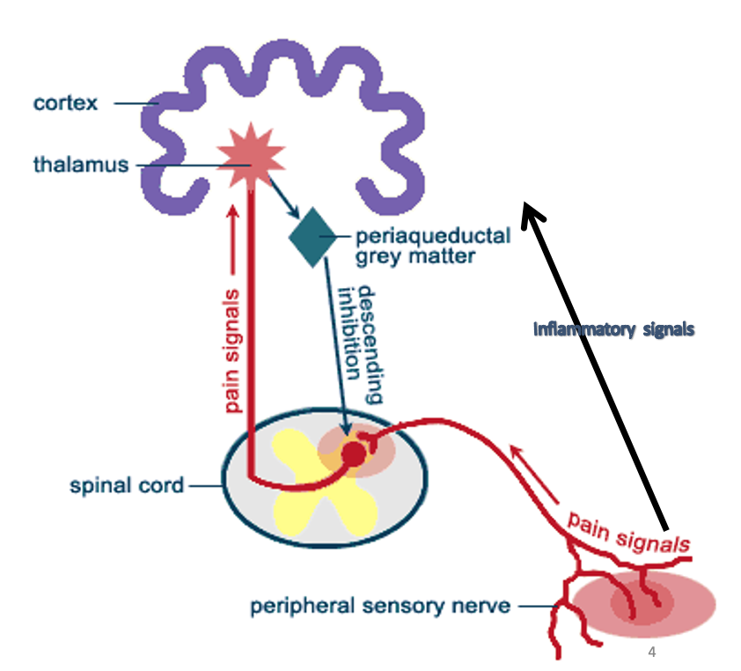

Simplify to 5 main pathways
NSAIDs
Notes:
Inflammatory signal pathway is the most ignored in acute pain.
Peripheral sensory – nerve blocks (MSO4 must get the the CNS first

Slide 21
Can Opioid-Free Analgesia be accomplished?
It is a new paradigm which calls for physicians and patients to reflect on current practice.

Slide 22
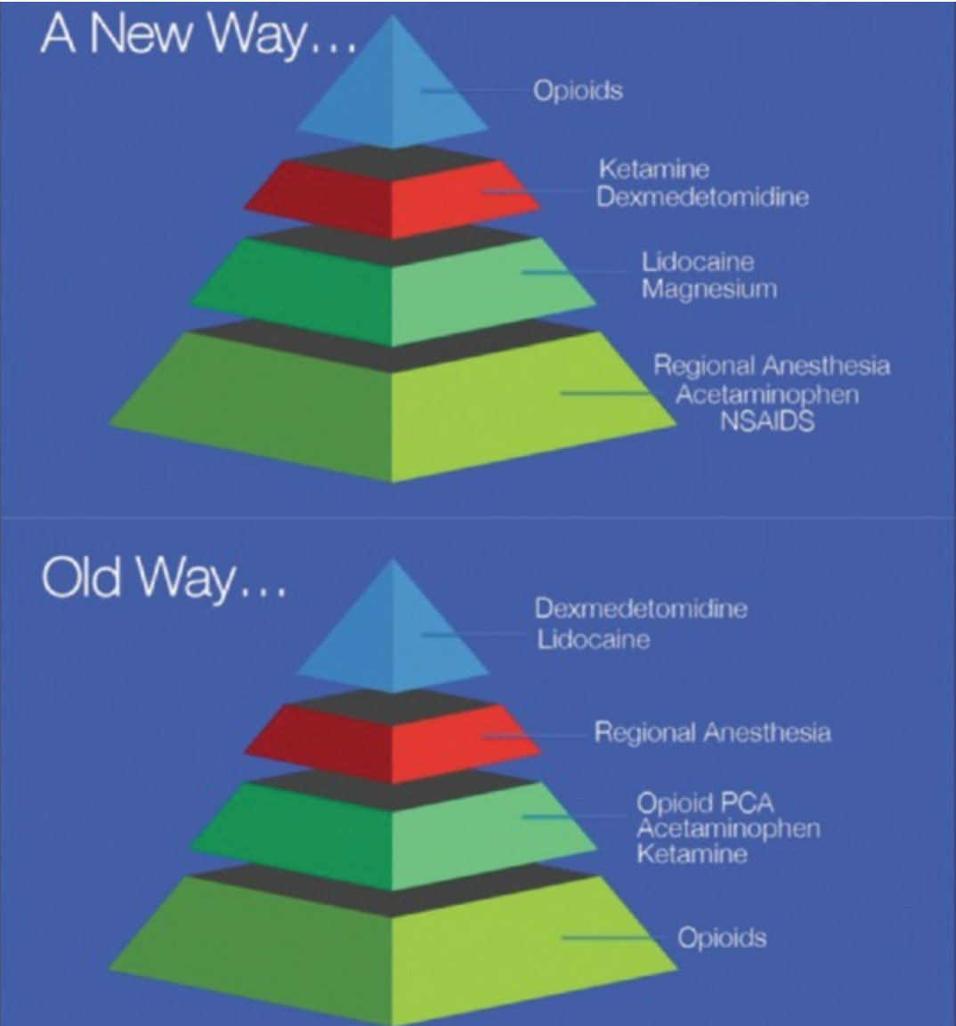
‘New paradigm in analgesia management’
‘The rising tide of opioid use and abuse: Role of Anesthesiologist’
Perioper Med 2018 Jul 3;7:16

Slide 23
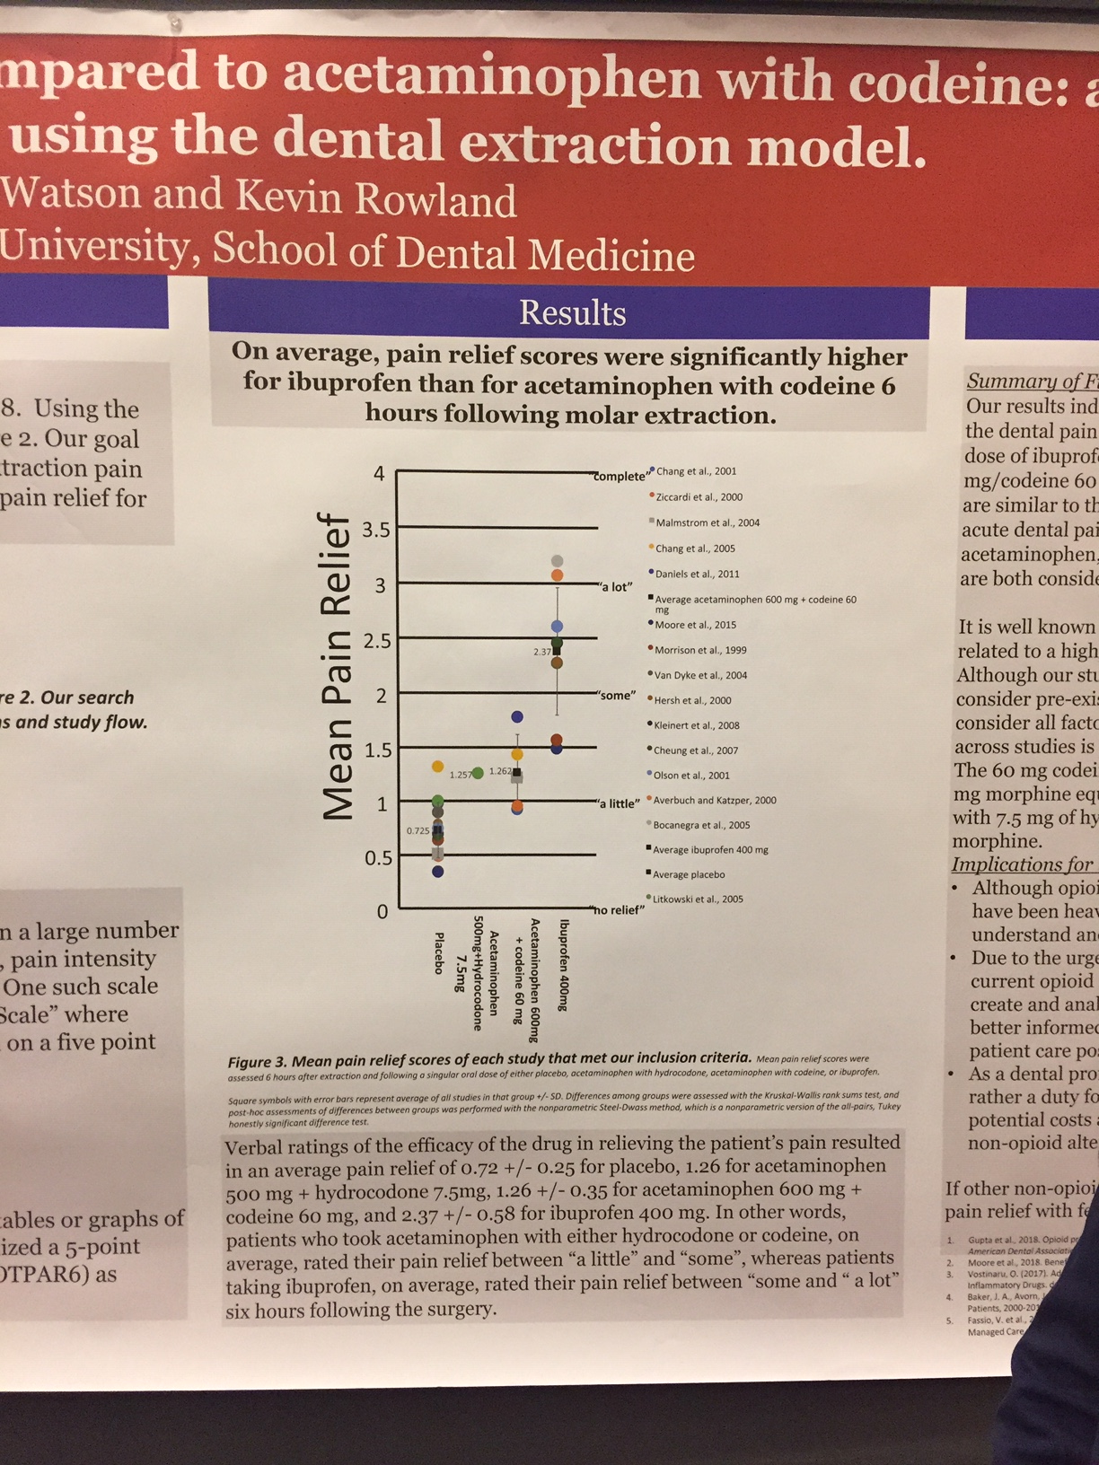
Opioids Actually Aren’t The Best For Acute Pain
Summary of studies for dental extraction pain relief
  Ibuprofen 400 better than T3 (Tylenol with codeine)
Studies for fracture relief
  Oral Morphine = ibuprofen; Morphine had more side effects
  Codeine = ibuprofen for pain; function better with ibuprofen
  T3 = ibuprofen for pain, more side effects and worse function with T3
Watson H, Rowland K. Pain Relief is greater with ibuprofen compared to acetaminophen with codeine: a systematic evalution of studies using the dental extraction method. PainWeek Postgraduate Medicine 9/2018 27:A
Poonai N et al. CMAJ. 2014 Dec 9;186(18):1358-63.
Braun CA Evid Based Nurs. 2010 Feb;13(1):10-1.
Drendel AL Ann Emerg Med. 2009 Oct;54(4):553-60
Ibuprofen 400
T3
Placebo
Notes:
Data from the Prescription Opioids and Heroin Epidemic in Georgia – white paper:
The highest rates of prescription opioid overdose deaths from 1999 to 2014 were among non-Hispanic whites and American Indian or Alaskan Natives, persons aged 25 to 54, and men. Rates of prescription overdose deaths are on the rise for women (Centers for Disease Control, CDC, 2016). Risk factors for prescription opioid misuse and overdose include doctor shopping (i.e., receiving overlapping prescriptions from multiple providers and pharmacies), taking high daily doses of prescription pain relieves, having mental illness or a history of substance misuse, being low- income, and living in a rural area (CDC, 2016).
According to Centers for Disease Control and Prevention, people at highest risk for heroin addiction are those addicted to prescription opioid painkillers, cocaine, marijuana and alcohol; people 18 to 25 years of age living in large metropolitan areas, and people without insurance or enrolled in Medicaid.

Slide 24

NSAIDs are an essential component of your Opioid Sparing / Opioid Free post surgical Pain Optimization Plan:
Opioids do not inhibit inflammatory signaling
when ignored, PAIN WINS.
Continuing to provide opioids contributes to persistent opioid use!

Slide 25
The “buy in”; Everyone has to be on board
The concern
Risks/ complications
Surgeon “Morphine works best!”
Acetaminophen
Ibuprofen
COX2 / Gabapentin
Patient Satisfaction
Less / No Opioids
Improved pain scores

Slide 26
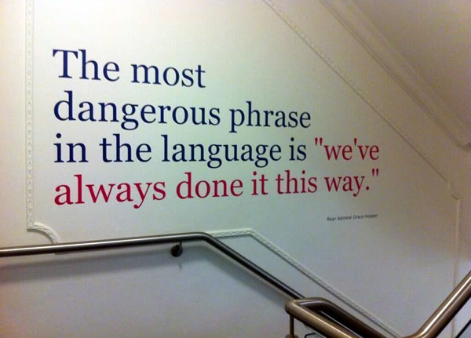
Rear Admiral Grace Murray Hopper, USN
Notes:
Admiral Grace Hopper- Pioneer in computer engineering- Humans are allergic to change, they love to say- “weve always done it this way”- that’s why I wear my watch counter clockwise

Slide 27
Empowering the PCPs & Patients/Families
PCPs and their multidisciplinary team are essential!
  Empower patients and parents to advocate for what’s best
  3-5 day Post-surgical transition to opioid-free / opioid sparing analgesia
  Education and patient materials are essential
  Patients / Parents / Family
  Empowered by PCP Team
  Equipped with 3-5 talking points for surgeon and anesthesiologist
  Understand reasonable expectations for pain and recovery
  Understand transition to non opioid analgesia within 3-5 days post-op
  Understand non-opioid, non-pharma options for pain management

Slide 28

DISCUSSION

Slide 29
Review Questions:
T / F Non-Opioid therapies should be encouraged as a primary treatment for post surgical pain.
T / F NSAID use should always be evaluated individually with each patient.
T / F Celecoxib (non-selective COX inhibitor) has a low risk of stomach bleeding and / or ulcer formation when used short-term.
T / F 9 out of 10 patients report that their pain is either mild or gone four days after surgery.
T / F Non-Pharmacologic therapies include Ice, Elevation, physical therapy, Vibration therapy.
T / F Short-Acting Opioids should be prescribed for no more than 3-5 days courses.
T / F Opioids are effective blocking pain caused by inflammation.
T / F Highly selective COX2 inhibitors, such as meloxicam, have minimal platelet aggregation inhibition.
T / F Non-Selective COX inhibitors inhibit platelet aggregation through inhibition of COX-1 and thromboxane A2 pathways
T / F The American College of Surgeons recommends beginning with non-medicine therapies, around the clock non-opioids, and limiting opioids to a few days.
T / F Special consideration should always be given to children when prescribing NSAIDs.
T / F The American College of Surgeons’ Surgical Patient Education recommendations states that anyone can become addicted to opioids, however, addiction is rare when opioids are used for 5 days or less.
T / F Special care should always be taken when combining prescribed NSAIDs with common over-the-counter medicines.
T / F Improved pain scores, and increased patient satisfaction is achievable with less or no opioids.
Answer Key: 1 – 6 True; 7 False; 8 – 14 True.

Slide 30
References:
http://www.ncbi.nlm.nih.gov/pubmed/23001694
http://onlinelibrary.wiley.com/doi/10.1002/hep.20948/pdf
“Acetaminophen Use Patterns” Presentation. https://www.pharmacoepi.org/meetings/28ICPE/
presentations/aj_oral_presentations_key.cfm
http://www.chpa.org/Templates/PressRelease.aspx?id=2717
Prescription Drug & Opioid Abuse Commission, Acute Care Opioid Treatment and Prescribing Recommendations, June 26, 2018.
American College of Surgeons ACS Patient Education Workgroup, www.facs.org/safepaincontrol, August 2019
Consumer Reports. Pain and anti-inflammatory drugs NSAID-cost comparison. http://www.consumerreports. org/health/resources/pdf/best-buy-drugs/2pager_ NSAIDs.pdf. Accessed August 17, 2009.
Wolfe MM, Lichtenstein DR, Singh G. Gastrointestinal toxicity of nonsteroidal antiinflammatory drugs [published correction appears in N Engl J Med. 1999;341(7):548]. N Engl J Med. 1999;340(24):1888-1899.
Blower AL, Brooks A, Fenn GC, et al. Emergency admissions for upper gastrointestinal disease and their relation to NSAID use. Aliment Pharm Ther. 1997;11(2):283-291.
Tarone RE, Blot WJ, McLaughlin JK. Nonselective nonaspirin nonsteroidal anti-inflammatory drugs and gastrointestinal bleeding. Am J Ther. 2004;11(1):17-25.
Barkin J. The relation between Helicobacter pylori and nonsteroidal anti-inflammatory drugs. Am J Med. 1998;105(5A):22S-27S.
Silverstein FE, Faich G, Goldstein JL, et al. Gastrointestinal toxicity with celecoxib vs nonsteroidal anti-inflammatory drugs for osteoarthritis and rheumatoid arthritis: the CLASS study: a randomized controlled trial. JAMA. 2000;284(10):1247-1255.
Witter J. Celebrex capsules (celecoxib) Medical officer review. http://www.fda.gov/ohrms/dockets/ac/01/ briefing/3677b1_03_med.pdf. Accessed August 17, 2009.
Silverstein F, Simon L, Faich G. Reporting of 6-month vs 12-month data in a clinical trial of celecoxib [in reply]. JAMA. 2001;286(19):2399-2400.
Rostom A, Dube C, Wells G, et al. Prevention of NSAID induced gastroduodenal ulcers. Cochrane Database Syst Rev. 2002;(4):CD002296.
Chan FK, Hung LC, Suen BY, et al. Celecoxib versus diclofenac and omeprazole in reducing the risk of recurrent ulcer bleeding in patients with arthritis. N Engl J Med. 2002;347(26):2104-2110.
Gillis JC, Brogden RN. Ketorolac. A reappraisal of its pharmacodynamic and pharmacokinetic properties and therapeutic use in pain management. Drugs. 1997;53(1):139-188.
He J, Whelton PK, Vu B, Klag MJ. Aspirin and risk of hemorrhagic stroke: a meta-analysis of randomized controlled trials. JAMA. 1998;280(22):1930-1935.
Knowles SR, Drucker AM, Weber EA, Shear NH. Management options for patients with aspirin and nonsteroidal antiinflammatory drug sensitivity. Ann Pharmacother. 2007;41(7):1191-1200.
Lesko SM, Mitchell AA. An assessment of the safety of pediatric ibuprofen. A practitioner-based randomized clinical trial. JAMA. 1995;273(12):929-933.
Patient Education:
Hill MV, McMahon ML, Stucke RS, Barth RJ, Jr. Wide Variation and Excessive Dosage of Opioid Prescriptions for Common General Surgical Procedures. Ann Surg. 2017;265(4):709-714.
2. Jones CM, Paulozzi LJ, Mack KA. Sources of prescription opioid pain relievers by frequency of past-year nonmedical use in the United States, 2008-2011. JAMA Intern Med. 2014;174(5):802-803.

