Slide 1
rEASON PROJECT
Rural Emergent Alternative Surgical Opioid Non-use
Closing the Door on Surgery as a Gateway to Persistent Use of Opioids
Module 5: Multimodal Analgesia; Concepts & Implementation: Regional Anesthesia
© 2021 Cornerstone Whole Healthcare Organization. All rights reserved.

Slide 2
about this course:
Goal: Educate stakeholders on the role of surgery as a gateway to persistent opioid use.
Means: Seven modules to promote understanding how and why surgery may lead to opioid use disorder.
Outcomes:
Providers will be able to educate patients about their options for surgical pain management.
Advocate for safe and effective opioid-free pain treatment and follow-up.
Achieve prevention of opioid use disorder.

Slide 3
01
Surgery as a Gateway to Persistent Opioid Use; Defining the problem
02
Opioids; From Friend to Foe
03
Opioid Induced Hyperalgesia
Curriculum Modules
Adolescents/Young Adults as a uniquely Susceptible Group
04
05
Multimodal analgesia; concept and implementation: Regional Anesthesia
06
Multimodal analgesia; concept and implementation: NSAIDs
Developing a Pain Management Plan: Responsible Follow-up& Transition of Care From Surgery
07

Slide 4
Module 4: Regional Anesthesia Objectives
Upon completion of this course, the learner will be able to:
Discuss the prevalence of opioid overuse as a complication of surgery
RECOGNIZE the difference between major blocks TECHNIQUES
VALUE multimodal pain management
RECOGNIZE patient misgivings about regional anesthesia
Understand the role of regional anesthesia as an alternative to opioids for the management of surgical pain
Formulate strategies to allow patients to advocate for regional anesthesia AS AN ALTERNATIVE TO OPIOIDS

Slide 5
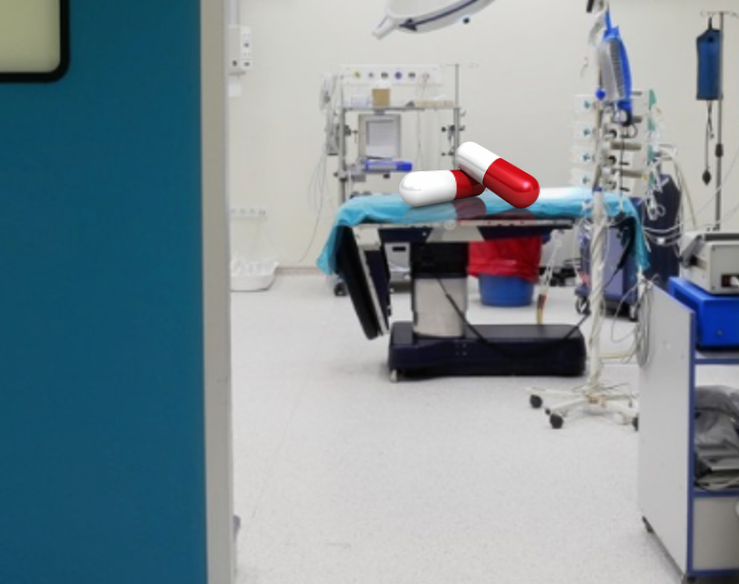
Closing a Silent Gateway to Opioid Use & Dependence

Slide 6
Review the Problem: Surgery has been a long-ignored gateway to persistent opioid use, dependence and addiction
Surgery is frequently the first-time patients are exposed to opioids
The role of opioids in treating postsurgical pain has been overlooked as a contributing factor to the opioid epidemic
Nearly 4.7-12% of surgical patients in 2017 continued to take opioids three to six months following surgery with as high as 17% for patients undergoing certain surgeries.
Clinicians treating surgical pain need the tools and resources to make evidence-based prescribing decisions that will adequately treat patients’ pain while minimizing opioid risks

Slide 7
Opioid-free and Opioid-sparing Analgesia: Focus on Regional Anesthesia/Nerve Blocks
Use of local anesthetics to block sensations of pain from a large area of the body, such as an arm or leg or the abdomen.
Allows a procedure to be done on a region of the body without being unconscious. Examples are spinal blocks and epidurals
Regional anesthesia doesn’t involve the complications & side effects that happen with sedation & general anesthesia.
Long-acting local anesthetics and continuous catheters can facilitate opioid-free analgesia

Slide 8
Movement away from perioperative opioid use is a necessary paradigm shift
Perioperative opioid prescription is an independent risk factor for chronic opioid use
Opioids should be reserved as rescue analgesia
Perioperative opioid sparing strategies endorse regional anesthesia & non-opioid pain management
Opioid free anesthesia combines various opioid sparing strategies to eliminate opioid usage.

Slide 9
Review of perioperative anesthesia options

Slide 10
General Anesthesia
Medications administered through a mask or an IV.
Patient is rendered unconscious
Pain and discomfort manifest as the general anesthesia wears off.
Opioids are commonly used to treat postoperative pain.

Slide 11
Sedation Anesthesia
Medications cause relaxation and sometimes sleep.
Used for minor surgeries or shorter, less complex procedures
Pain and discomfort manifest as the sedation wears off.
Opioids are commonly used to treat postoperative pain.

Slide 12
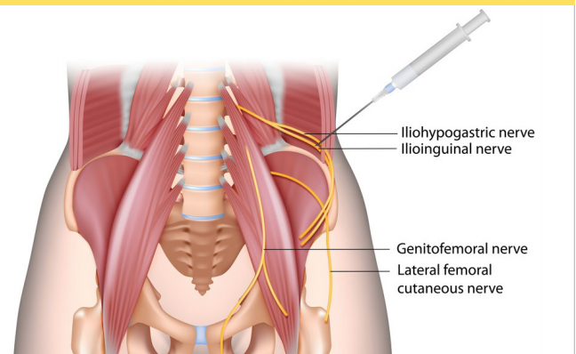
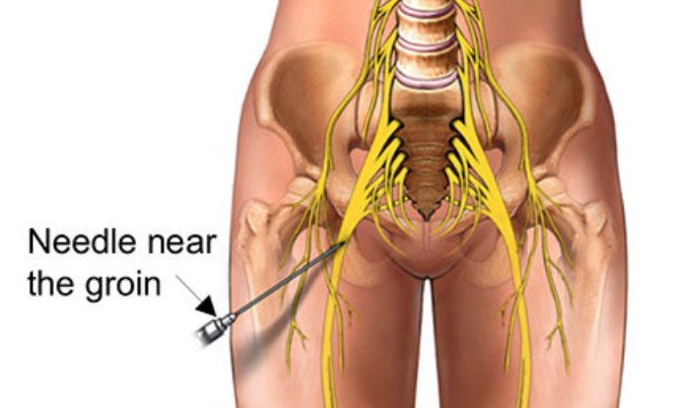
Regional Anesthesia/ Nerve Blocks
Numbs a large part of the body,
Waist down
Single arm or leg
Chest or abdominal wall
Local anesthetic is injected close to a nerve, a bundle of nerves, or the spinal cord.
Allows a procedure to be done on a region of the body without being unconscious.
Usually involves concomitant sedation
Excellent opioid-sparing properties

Slide 13
Major types of regional anesthesia include:
Peripheral nerve blocks. A local anesthetic is injected near a specific nerve or bundle of nerves to block sensations of pain from the area of the body supplied by the nerve. Nerve blocks are most commonly used for surgery on the arms and hands, the legs and feet, the groin, or the face.
Epidural and spinal anesthesia. A local anesthetic is injected near the spinal cord and major nerves that enter the spinal cord to block sensations of pain from an entire region of the body, such as the lower abdomen, the hips, or the legs.

Slide 14
Skill & experience are needed to inject the anesthetic properly
Increased emphasis on nerve blocks in anesthesiology training
ACGME newly approved Regional Anesthesia & Pain Medicine Fellowship
RAPM journal is the highest impact journal in anesthesiology worldwide

Slide 15
BLOCKS; the menu
Rectus Sheath Block (RSB)
Serratus Plane Block (SAP)/ PECS
Quadratus Lumborum block (QLB)
Pudendal blocks
Erector Spinae Plane (ESP) block
Brachial Plexus
Paravertebral blocks (PVB)
Femoral
Sciatic

Slide 16
What surgeries are most appropriate for regional anesthesia? If it has a nerve supply, it can be blocked
Major Surgery
Minor Surgery
Adults / Elderly
Children

Slide 17
But it’s JUST Laparoscopic!
Notes:
Remember… Minimally invasive DOES NOT mean minimal pain!

Slide 18
Notes:
Beretsky: Half the kids were up on the floor with pain scores greater than

Slide 19
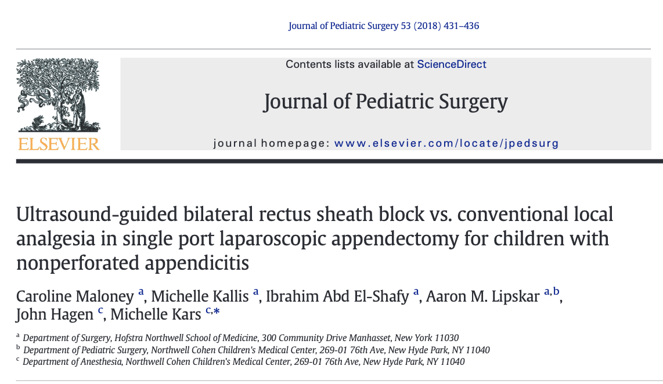
Rectus sheath block vs infiltration in 275 children
Decreased opioid consumption
Lower pain scores
Only added 6.67 minutes time under anesthesia
17.8% of children with RSB had Opioid Free hospital stays

Slide 21
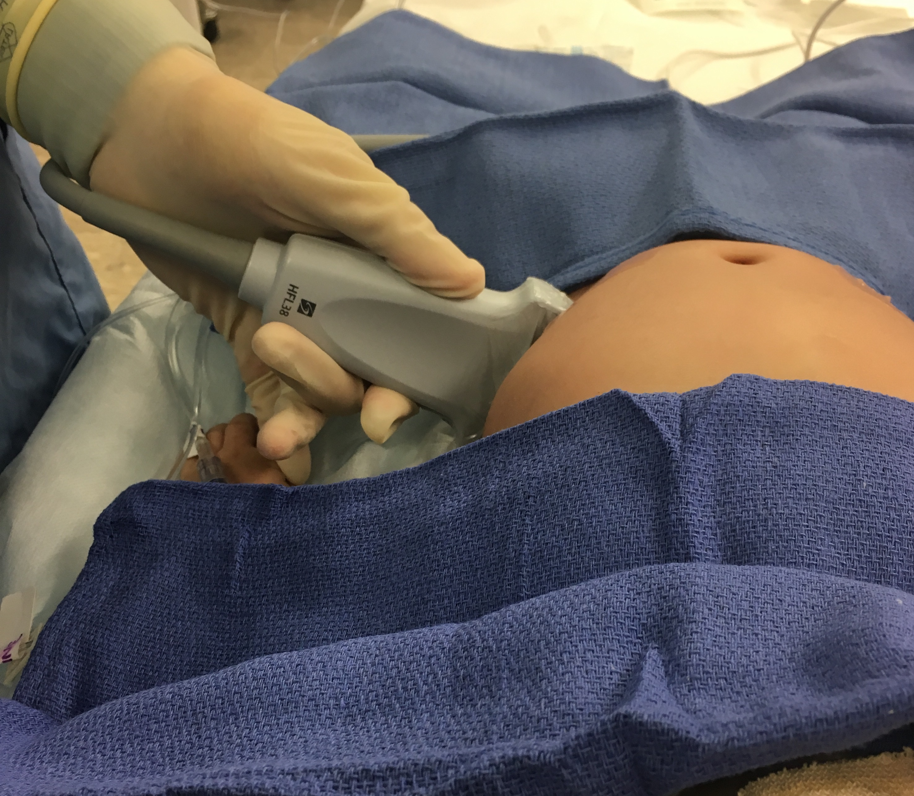
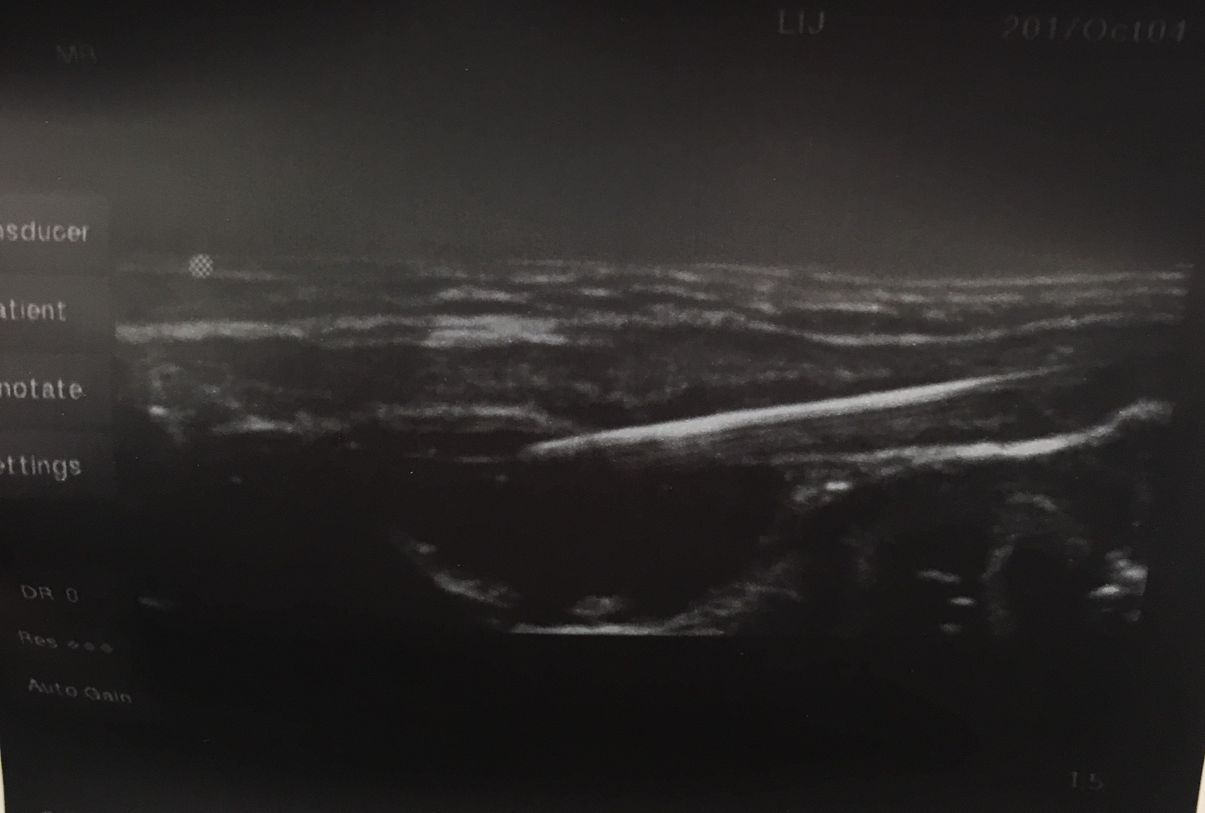
Quadratus Lumborum block for Laparoscopic Inguinal hernia repair (n = 48)
Notes:
A slide to dwell on…

Slide 22
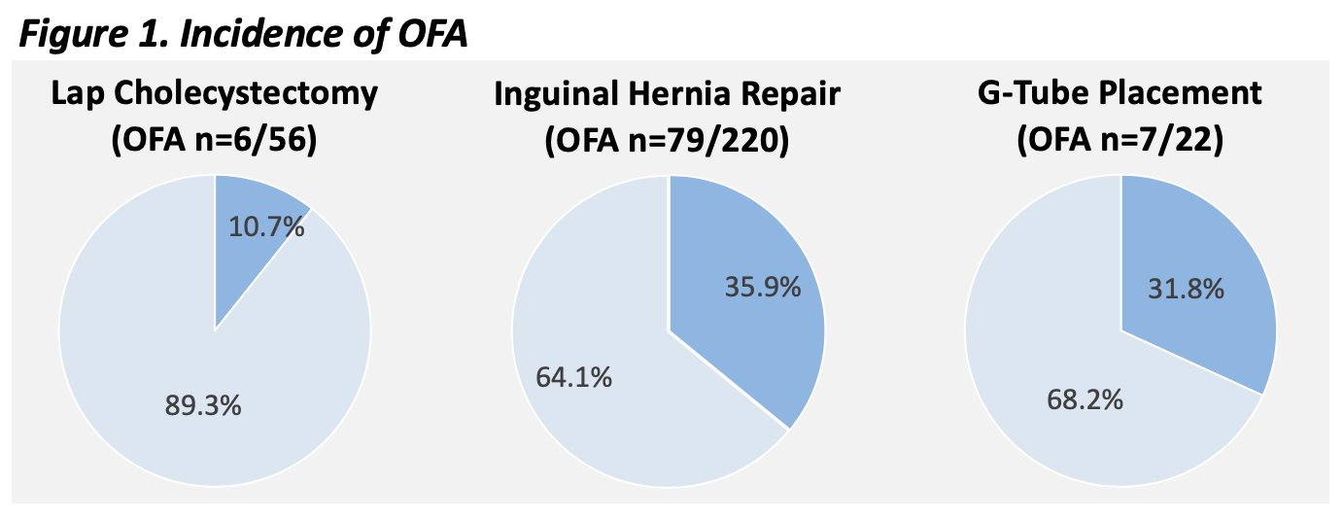
Incidence of Opioid-Free Anesthetics (OFA) in Pediatric General Surgery
Notes:
OFA and Opioid Sparing was not a goal of the study

Slide 24
242 (Total)
23
(Peds)

Slide 25
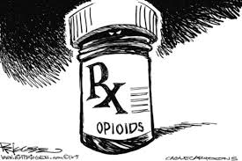
76%

Slide 26
Enhanced Recovery After Surgery (ERAS)
Can apply to MOST surgeries
Regional anesthesia integral component
Appendectomies
Colorectal surgeries
Laparoscopic Inguinal Hernia
Pectus Excavatum Repair

Slide 27
Surgery is a team effort; but this is not the entire team!

Slide 28
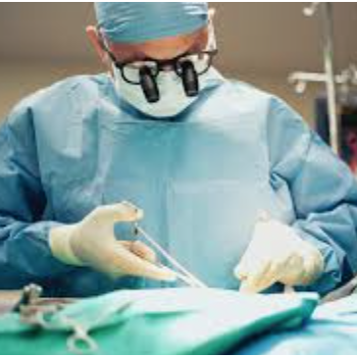
This is the Team!
Patient / Parents
Internists/ Family Practice/ Pediatrician
Surgeon/ Anesthesiologist
Pharmacist / Behavioral Health

Slide 29
The “buy in”; Everyone has to be on board
The concern
Risks/ complications
Surgeon “Delay”
Block benefits
Patient Satisfaction
Less Opioids
Improved pain scores

Slide 30
Rear Admiral Grace Murray Hopper, USN
Notes:
Admiral Grace Hopper- Pioneer in computer engineering- Humans are allergic to change, they love to say- “weve always done it this way”- that’s why I wear my watch counter clockwise

Slide 31
Surgical hesitation/barriers
“Regional anesthesia induction takes too long, it slows me down” – Surgeon
5-10 minute induction times reduced to zero with proper workflows
Efficacy: “they don’t work”
Complications: “nerve damage”

Slide 32
Patient Misconceptions
Nerve Damage?
Adult: incidence 1.5/10,000
Pediatric: Less than 1/100,000
Being awake for the block procedure, is it painful?
Patients are sedated
About as painful as an uncomplicated IV placement

Slide 33
Post-operative Neurologic Symptoms
Neurologic abnormality at/or beyond 12 months after surgery
.029-.2%
9X more likely to be from non-anesthesia-related cause than from nerve block
Orthopedic surgery: high risk of post-operative neurologic symptoms

Slide 34
Transient Neurologic Symptoms

Slide 35
Empowering the PCPs & Patients/Families
PCPs and their multidisciplinary team are essential!
Empower patients and parents to advocate for what’s best
3-5 day Post-surgical Transition to opioid-free / opioid sparing analgesia
Education and patient materials are essential
Patients / Parents / Family
Empowered by PCP Team
Equipped with 3-5 talking points for surgeon and anesthesiologist
Understand reasonable expectations for pain and recovery
Understand transition to non opioid analgesia within 3-5 days post-op
Understand non-opioid, non-pharma options for pain management

Slide 36
DISCUSSION

Slide 37
Review Questions:
T / F Peripheral nerve blocks are not appropriate for minor surgical procedures.
T / F In pain management, regional anesthesia should be prioritized over opioids.
T / F Peripheral nerve blocks last longer and are thus more useful than epidurals and spinals in pain management for ambulatory surgical procedures.
T / F Nerve blocks must be administered with patients fully awake.
T / F Nerve blocks work best when coupled with anti inflammatory medications.
T / F Nerve blocks have a high incidence of complications
T / F The overall risk of a nerve block is much lower than the risk of a 7 day opioid prescription
T / F Patients and hospital systems would benefit from greater understanding of the value of regional anesthesia
Answer Key: 1-F, 2/3-T, 4-F, 5-T, 6-F, 7-T, 8-F, 9-T

