Slide 1

rEASON PROJECT
Rural Emergent Alternative Surgical Opioid Non-use
Closing the Door on Surgery as a Gateway to Persistent Use of Opioids
Module 4: Adolescents and Young Adults; Uniquely Susceptible to OUD
© 2021 Cornerstone Whole Healthcare Organization. All rights reserved.

Slide 2
about this course:
Goal: Educate stakeholders on the role of surgery as a gateway to persistent opioid use.
Means: Seven modules to promote understanding how and why surgery may lead to opioid use disorder.
Outcomes:
Providers will be able to educate patients about their options for surgical pain management.
Advocate for safe and effective opioid-free pain treatment and follow-up.
Achieve prevention of opioid use disorder.

Slide 3
01
Surgery as a Gateway to Persistent Opioid Use; Defining the problem
02
Opioids; From Friend to Foe
03
Opioid Induced Hyperalgesia
Curriculum Modules
Adolescents/Young Adults as a uniquely Susceptible Group
04
05
Multimodal analgesia; concept and implementation: Regional Anesthesia
06
Multimodal analgesia; concept and implementation: NSAIDs
Developing a Pain Management Plan: Responsible Follow-up& Transition of Care From Surgery
07

Slide 4
Adolescents & young adult Module Objectives
Upon completion of this course, the learner will be able to:
Understand the problem of surgery as a gateway to persistent opioid use
discuss how adolescent brain development contributes to addictive vulnerability
Discuss why adolescents & young adults are uniquely susceptible to oud
Discuss illicit drug use in Grades 8 through 12
Discuss opioid sparing alternatives to opioid monotherapy
Discuss persistent use of opioids in pediatric patients following surgery

Slide 5

Adolescents/young adults; uniquely susceptible to OUD
rEASON PROJECT

Slide 6
Review the Problem:
Surgery has been a long-ignored gateway to persistent opioid use, dependence and addiction
Surgery is frequently the first-time patients are exposed to opioids
The role of opioids in treating postsurgical pain has been overlooked as a contributing factor to the opioid epidemic
Nearly 4.7-12% of surgical patients in 2017 continued to take opioids three to six months following surgery with as high as 17% for patients undergoing certain surgeries.
Clinicians treating surgical pain need the tools and resources to make evidence-based prescribing decisions that will adequately treat patients’ pain while minimizing opioid risks
rEASON Project

Slide 7


* Opioid naïve 15-year-old Soccer player with
Surgical ACL Repair
- Morphine IV in PACU & 30 oxycodone for home;“Likes the way Morphine and oxycodone make him feel”
- OUD at 2 years post surgery
Case in Point:

Slide 8
90% of people with substance addictions began using before age 18.
Substance abuse before the age of 15 makes a person 6.5 times more likely to develop a long term substance use disorder.

Slide 9

2017; illicit drug use other than marijuana
5.8percent among 8th graders,
9.4 percent among 10th graders,
13.3percent among 12th graders.

Slide 10
Why teens?
Designed to take risks & be rewarded
Designed to learn fast

Slide 11
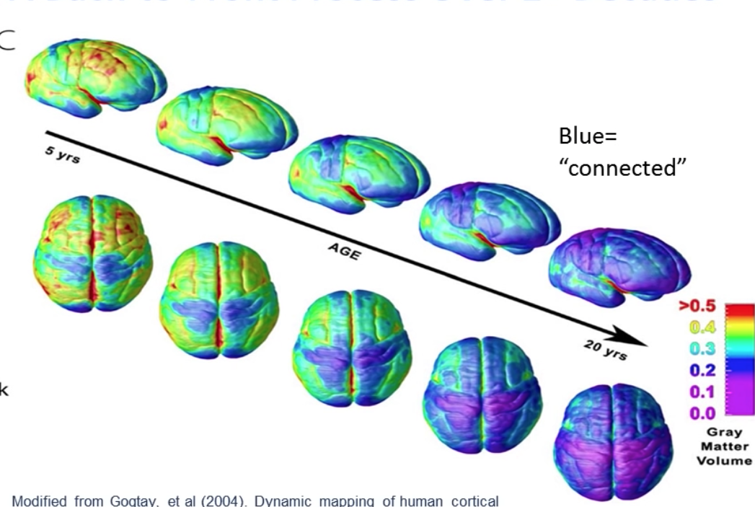
Brain connectivity over 20 years

Slide 12

Teenage brain have incomplete connections between limbic system and the prefrontal cortex
Poor impulse control
Poor weighing of risks
High reward responses
Low baseline levels of dopamine

Slide 14

WHY?
Teens must take risks necessary for adulthood
  * start a job
  * leave home
  * form relationships

Slide 15
Why teens?
Also; Faster learners

Slide 16
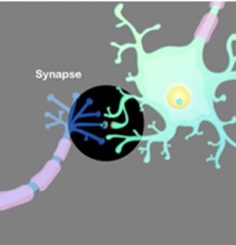
Synapses; connections of the brain
The ability of synapses to change themselves is called synaptic plasticity.
Learning is persistent changes in the number and shape of synapses, as well as the amount of neurotransmitter and number of receptor

Slide 17
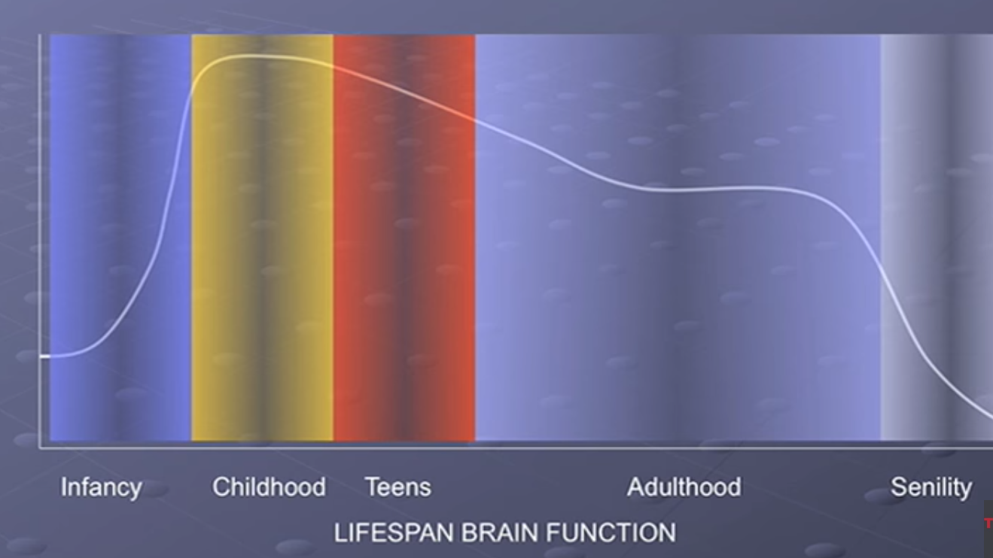

Slide 18
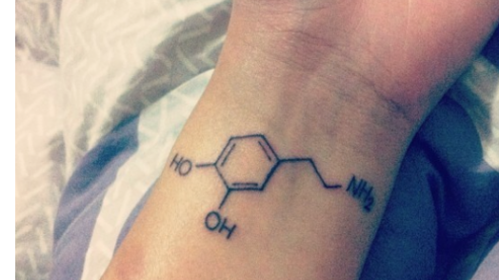
Dopamine;
Neurochemical learning
Goal-directed motivation is learned
Selective rewards of random infant behavior
Dopamine reinforces life-sustaining behavior (eating, staying warm)

Slide 19
Basically, addiction is a form of learning and teens are designed to learn
Brain learns via reward system
Learning occurs in the addiction centers
Teens get addicted harder, stronger, and faster

Slide 20
And, don’t discount social pressure
Social benefits from smoking, drinking, or sexual activity.
In schools and communities where the popular students are more likely to smoke, drink, & be sexually active, trying out these risky behaviors is viewed as way to gain approval

Slide 21
What is the incidence of continued opioid use in the opioid naïve adolescent after routine surgery?
What are teens “learning” in the perioperative experience?

Slide 22
Harbaugh Study 2017
88,637 patients ages 13 to 21 years in the United States
Opioid naïve = no opioids in the 12 months before surgery
Received an outpatient opioid prescription for pain management
Prolonged opioid refills as a surrogate for persistent opioid use after surgery

Slide 23
Opioid-naïve: No opioid prescriptions in the 366 days preceding surgery
The perioperative surgical period is defined as 30 days prior to surgery to 14 days post-discharge.
Newly persistent opioid users. Patients receiving a opioid prescription 90 days to 180 days post-discharge

Slide 24
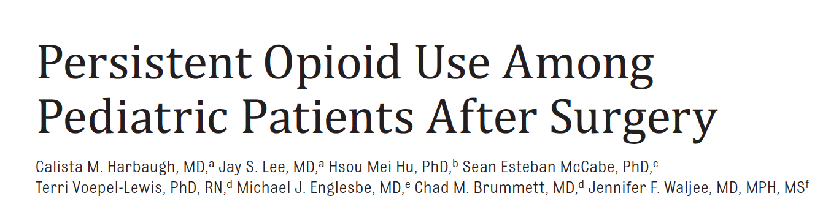
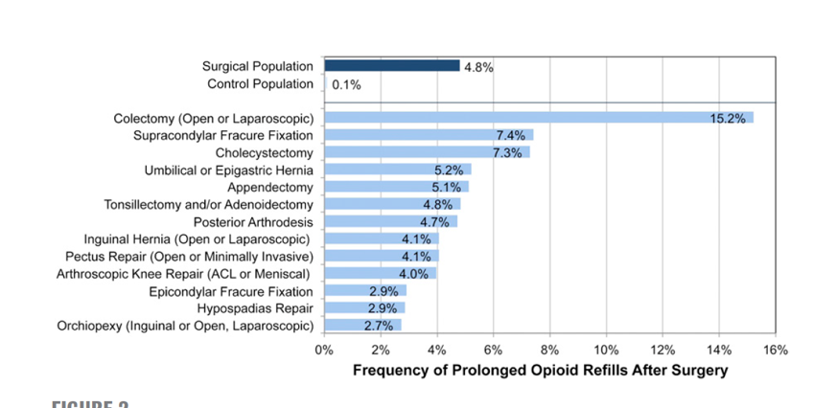

Slide 25
Monitoring the Future Study
73% of eighth-graders perceived an occasional use of heroin as high risk compared with
26% who perceived an occasional use of Vicodin and
33% who perceived an occasional use of OxyContin as high risk.
More prone to use these medications, which are perceived as a pain medication,
Notes:
…And the doctor gave it to you…

Slide 26
Prevention of opioid-associated morbidity and mortality.
Emphasis on multimodal analgesic techniques and avoid unnecessary opioid exposure
Providers need to identify evidence-based strategies for safe postoperative prescribing, appropriate patient and parent education
Proper disposal avenues for unused medications

Slide 27

Discussion

Slide 28
Review Questions:
T / F The percentage of illicit drug use more than doubles between 8th and 12th grade.
T / F The teenage brain has incomplete connections between the limbic system and prefrontal cortex, resulting in poor impuls control, risk assessment, and high rewarding of risk taking.
T / F Teens are faster learners, and addiction is a form of learning due to neuroplasticity.
T / F Opioids trigger endorphin release, muffling the perception of pain, boosting feelings of pleasure, and creating a powerful sense of well-being.
T / F Lifespan brain function peaks in Childhood through teenage years.
T / F Approximately 75% of 8th Graders viewed occasional use of Heroin as high risk, but only 26-33% view Vicodin & OxyContin as high risk due to their perception as pain medications.
Answer Key: 1 – 6: True

