Slide 1

rEASON PROJECT
Rural Emergent Alternative Surgical Opioid Non-use
Closing the Door on Surgery as a Gateway to Persistent Use of Opioids
Module 3: Opioid Induced Hyperalgesia
© 2021 Cornerstone Whole Healthcare Organization. All rights reserved.

Slide 2
about this course:
Goal: Educate stakeholders on the role of surgery as a gateway to persistent opioid use.
Means: Seven modules to promote understanding how and why surgery may lead to opioid use disorder.
Outcomes:
Providers will be able to educate patients about their options for surgical pain management.
Advocate for safe and effective opioid-free pain treatment and follow-up.
Achieve prevention of opioid use disorder.

Slide 3
01
Surgery as a Gateway to Persistent Opioid Use; Defining the problem
02
Opioids; From Friend to Foe
03
Opioid Induced Hyperalgesia
Curriculum Modules
Adolescents/Young Adults as a Uniquely Susceptible Group
04
05
Multimodal analgesia; concept and implementation: Regional Anesthesia
06
Multimodal analgesia; concept and implementation: NSAIDs
Developing a Pain Management Plan: Responsible Follow-up& Transition of Care From Surgery
07

Slide 4
Opioids; from friend to foe Module Objectives
Upon completion of this course, the learner will be able to:
Understand the problem of surgery as a gateway to persistent opioid use
Discuss historical observations of opioid induced hyperalgesia
Discuss development of opioid induced hyperalgesia in the post surgical patient
Understand the challenges of managing opioid induced hyperalgesia
Discuss the complexity of pain pathways and why multiple analgesic techniques improve outcomes
discuss opioid sparing alternatives to opioid monotherapy

Slide 5
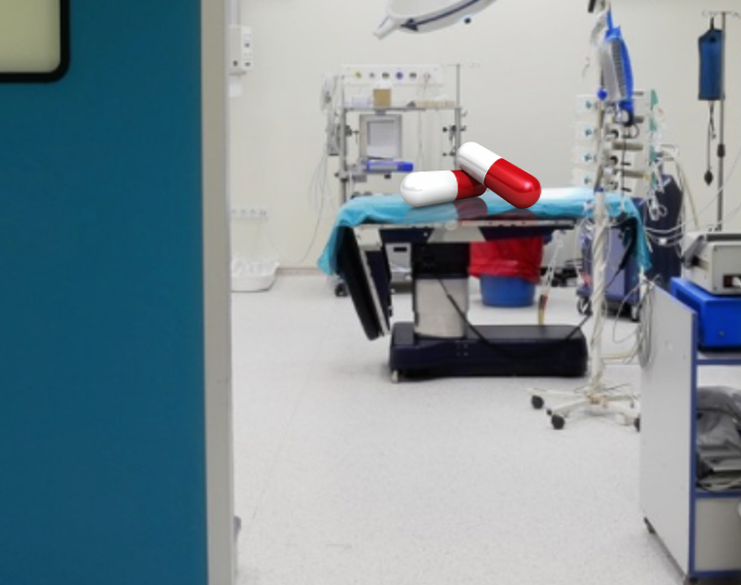
Closing a Silent Gateway to Opioid Use & Dependence

Slide 6
Review the Problem:
Surgery has been a long-ignored gateway to persistent opioid use, dependence and addiction
Surgery is frequently the first-time patients are exposed to opioids
The role of opioids in treating postsurgical pain has been overlooked as a contributing factor to the opioid epidemic
Nearly 4.7-12% of surgical patients in 2017 continued to take opioids three to six months following surgery with as high as 17% for patients undergoing certain surgeries.
Clinicians treating surgical pain need the tools and resources to make evidence-based prescribing decisions that will adequately treat patients’ pain while minimizing opioid risks

Slide 7
Can Opioid therapy make pain worse?
Hyperalgesia: increased pain response to painful stimuli
Opioid induced hyperalgesia (OIH): is a state of enhanced pain sensitization in opioid users
Notes:
Allodynia

Slide 8
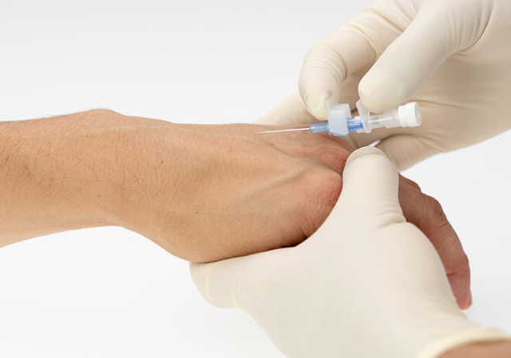
2019 Observations: Clayton Dalton, MD
Dept. Emergency Medicine, Mass General.
Observations with IV Starts in ED:
  “for some patients, this routine becomes excruciating; putting one in (an IV start) is quick and simple, and its no more painful than a mild bee sting.”
  “Hypersensitive patients often had a history of opioid use”
  “Shouldn’t these patients be less susceptible to pain, instead of more so?”

Slide 9
  Began prospective Real World Experience study, as well as retrospective investigation.
  Here is what he found:
    He wasn’t the 1st to document this observation… nor the 2^{nd…}
    True incidence is unknown due to paucity of literature and methodological challenges, but
      Studies in three patient populations provide insight to OIH:
        Former opioid addicts maintained on methadone
        Surgical inpatients receiving opioids
        Healthy volunteers who are administered opioids acutely and then undergo pain tolerance testing.

Slide 10
OIH Evidence Group 1:
Former opioid addicts on methadone maintenance
      Evidence to support OIH development
      Increased pain sensitivity with a cold pressor test compared to healthy matched controls
      Weakness:
        cross-sectional in design and do not
        No control for possible differences in pre-opioid pain processing

Slide 11
OIH Evidence Group 2:
Surgical patients receiving intraoperative opioids
  Prospective studies
  Increased intraoperative opioids = increased pain scores & increased postoperative opioid requirement
  Sample study design:
  60 patients undergoing hysterectomy
  Randomized for fentanyl induction dose
    low dose (1 μg· kg ⁻¹ )
    high dose (15 μg· kg ⁻¹ )
  Results: High dose group with higher pain scores postoperatively & higher opioid requirement compared to the low dose group
  ??????????? Doesn’t make sense does it?
Notes:
Most anesthesiologists would say that 10mcg would be considered high dose fentanyl induction dose

Slide 12
  OIH Evidence Group 3: Three different studies
  Healthy human volunteers exposed to short term opioids (mostly remifentanil)
  Model: Secondary hyperalgesia & cold stressor induced pain
    Conclusion: short-term opioid administration induced hyperalgesia
Model: Double blind, randomized, crossover, placebo-controlled, opioid naive
  Remifentanil infusion
  Pain sensitivity testing at 30 minutes after infusion stopped
  Skin area with pre-existing hyperalgesia was significantly enlarged after remifentanil infusion was stopped
Model: 10 healthy volunteers, capsaicin induced mechanical hyperalgesia, remifentanil infusion
  all patients experienced enlargement hyperalgesia area by up to 180 ± 47% .
Notes:
Remifentanil findings resulting in more post op pain; conflicting studies
Plunge hand into cold bucket

Slide 13
1800’s; first reports of OIH
Pioneers
Sir Clifford Albutt, MD. On the abuse of hypodermic injections of morphia. Practitioner 1870; 5:327-331
“Pain, which I know is an evil, is less injurious than morphia, which may be an evil.” “Does morphia tend to encourage the very pain it pretends to relieve?”
Michael Joseph Rossbach, MD. Ueber die Gewoehnung an Gifte. Pflugers Arch Gesamte Physiol Menschen 1880; 21 : 213 – 25
“when dependence on opioids finally becomes an illness of itself, opposite effects like restlessness, sleep disturbance, hyperesthesia, neuralgia, and irritability become manifest.”
Notes:
Ueber die Gewoehnung an Gifte. Pflugers Arch Gesamte Physiol Menschen : About Getting Used to Poison; Pflugers Human Physiologic Medicine

Slide 14
Opioid Induced Hyperalgesia: Pathophysiology
Mechanisms: Complex, Interconnected, Neurobiologically multifactorial, Peripheral and central nervous system involvement
neurobiological systems initially respond to opioids with analgesia but neuroplasticity induces subsequent enhanced nociception
numerous studies show allodynia and/or thermal hyperalgesia occurs after the administration of heroin , fentanyl , and intrathecal morphine.
chronic pain patients using morphine demonstrate development of hyperalgesia within a month
Notes:
Systematic review performed by Angst & Clark led to the development of the OIH Model. More studies are needed.

Slide 15
3 Theories on progression to Opioid Induced Hyperalgesia:
1. Silverman, 2009: NMDA receptors become activated and when inhibited, prevent the development of tolerance and OIH
when the glutamate transporter system is inhibited, there are increases in the amount of glutamate available to NMDA receptors
cross talk of neural mechanisms of pain and tolerance may exist
prolonged morphine administration induces neurotoxicity via NMDA receptor mediated apoptotic cell death in the dorsal horn
This NMDA mediated mechanism via the central glutaminergic system sensitizes the neurons and may partially explain the development of OIH
Notes:
These four findings taken together propose a mechanism where the NMDA receptor if inhibited can lead to the prevention of OIH

Slide 16
3 Theories on progression to Opioid Induced Hyperalgesia:
2. Activation of descending pain pathways from the rostral ventromedial medulla which causes certain neurons to respond uniquely to opioids
  Experiments using injections of local anesthetics into the rostral ventromedial medulla or surgical lesioning of the dorsolateral funiculus demonstrate that descending pain pathways play a role in the genesis of OIH
3. Finally, decreased reuptake of neurotransmitters enhancing certain aspects of the pain pathway, as well as individual genetic factors, may also play a factor in the pathophysiology of OIH
Notes:
Pathophysiology of OIH is complex and interconnected. Although advances have been made to untangle this web, much more work and discovery lay ahead.
It is evident from these proposed mechanisms that the underlying pathophysiology of OIH is complex and interconnected. Although advances have been made to untangle this web, much more work and discovery lay ahead.

Slide 17
Diagnosing Opioid Induced Hyperalgesia:
No official criteria or guidelines; Eisenberg:
Paradoxical Increase in pain with increase in opioid dose.
Not exclusive to chronic users. Also occurs with short course of opioids, including the peri-operative setting
OIH is not restricted to the location of injury or disease;
  Generalized, diffuse, and ill defined pain; all despite increasing opioid doses.
Increasing pain not explained by the underlying condition
  Important to rule out
Often confused with tolerance or even withdrawal (similar symptoms)
  Allodynia and hyperalgesia occur in tolerance, withdrawal and OIH.
  Difficult to differentiate.
  OIH is considered a separate and distinct condition.
Notes:
It is evident from these proposed mechanisms that the underlying pathophysiology of OIH is complex and interconnected. Although advances have been made to untangle this web, much more work and discovery lay ahead.

Slide 18
Management: Opioid Induced Hyperalgesia
Very challenging & time consuming
Options:
Wean Opioids:
  Patients often do not understand the paradoxical nature of OIH and decreasing opioids can provokes apprehension and hostility
Opioid Rotation:
  Reasonable data demonstrating improved analgesia with opioid rotation; especially methadone
NMDA antagonists:
  might prevent opioid tolerance in perioperative setting- data/evidence not robust.
  Ketamine efficacious for patients on high dose opioids in both acute and chronic setting.
Notes:
It is evident from these proposed mechanisms that the underlying pathophysiology of OIH is complex and interconnected. Although advances have been made to untangle this web, much more work and discovery lay ahead.

Slide 19
Management: Opioid Induced Hyperalgesia
Options continued:
pregabalin, propofol, and Cox-2 inhibitors
Each interacts at different pain receptors
  pregabalin at neuronal tissues
  propofol at the GABA receptors
  COX-2 inhibitors through inhibition of prostaglandin synthesis
α-2 agonist data mixed,
  animal and human studies did not always produce similar outcomes.
Notes:
Alpha-2: most common is clonidine or Dexmedetomidine
It is evident from these proposed mechanisms that the underlying pathophysiology of OIH is complex and interconnected. Although advances have been made to untangle this web, much more work and discovery lay ahead.

Slide 20
Conclusions: Opioid Induced Hyperalgesia
First discussed 150 years ago….
Poorly understood paradox
Physicians need options for treatment
Best Option: Prevention
  Perioperative
  Postoperative Transition of care to Multimodal / non-opioid pain management within 5 days, 3 days optimal.
Notes:
It is evident from these proposed mechanisms that the underlying pathophysiology of OIH is complex and interconnected. Although advances have been made to untangle this web, much more work and discovery lay ahead.

Slide 21
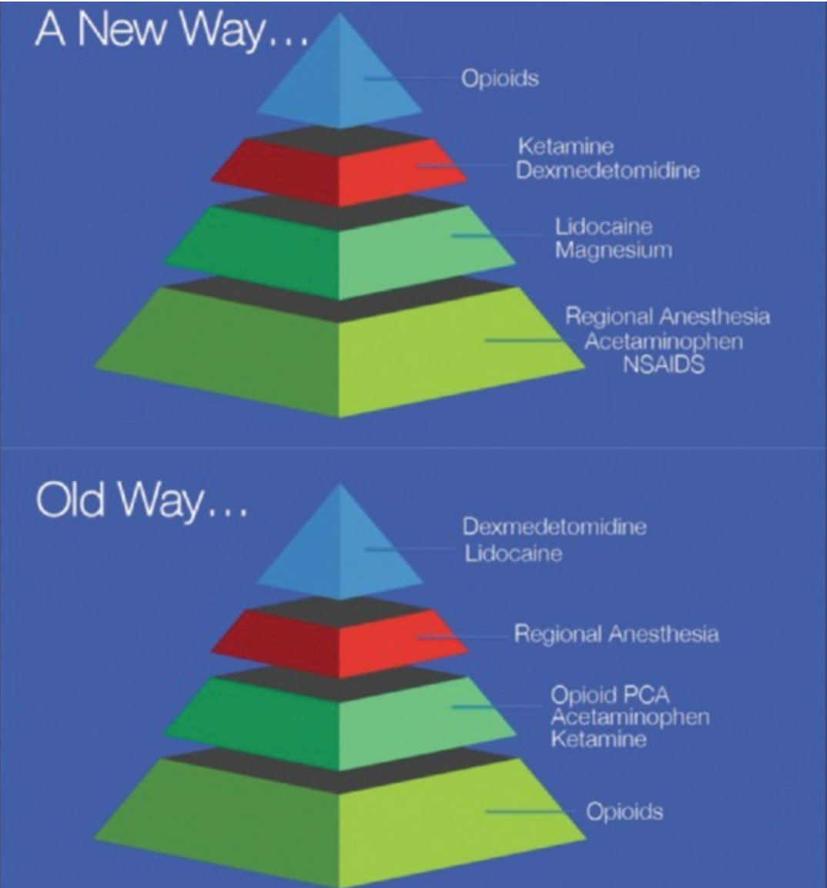
‘New paradigm in analgesia management’
Perioper Med 2018 Jul 3;7:16

Slide 22

Rear Admiral Grace Murray Hopper, USN
Notes:
Admiral Grace Hopper- Pioneer in computer engineering- Humans are allergic to change, they love to say- “weve always done it this way”- that’s why I wear my watch counter clockwise

Slide 23

DISCUSSION

Slide 24
References:
Merskey H. Bogduk N, Part III: Pain Terms, A Current List with Definitions and Notes on Usage Classification of Chronic Pain, Second Edition, IASP Task Force on Taxonomy. Seattle: IASP Press; 1994: 209–214
Albutt C. On the abuse of hypodermic injections of morphia. Practitioner 1870; 5: 327 – 31
Compton P, Charuvastra VC, Ling W. Pain intolerance in opioid-maintained former opiate addicts: Effect of long-acting maintenance agent. Drug Alcohol Depend 2001; 6: 139 – 46.
Lee M et al. A comprehensive review of opioid-induced hyperalgesia. Pain Physician 2011; 14: 145 – 61.
Chu L, Angst MS, Clark D et al. Opioid-induced hyperalgesia in humans; Molecular mechanisms and clinical considerations. Clin J Pain 2008; 24: 479 – 96.
Ramasubbu C, Gupta A. Pharmacological treatment of Opioid-induced Hyperalgesia: A review of the Evidence. J Pain Palliative Care Pharmcother 2011; 25: 219 – 30.
Mercandante S, Arcuri E, Hyperalgesia and opioid switching. Am J Hospice Palliative Med 2005; 22: 291 – 4.
Berna C, Kulich R, Rathmell JP et al. Tapering long-term opioid therapy in chronic noncancer pain: Evidence and recommendations for everyday practice. Mayo Clin Proc 2015; 90: 828 – 42.
Eisenberg E, Suzan E et al. Opioid-induced hyperalgesia (OIH): A real clinical problem or just an experimental phenomenon? J Pain Symptom Manage 2015; 49: 632 – 6.
Low Y, Clarke CF, Huh BK et al. Opioid-induce hyperalgesia: A review of epidemiology, mechanisms and management. Singapore Med J 2012; 53: 357– 60.
Chu LF, Angst MS, Clark D et al. The endogenous opioid system is not involved in modulation of opioid-induced hyperalgesia, J Pain 2011; 12: 108 – 15.
Yi P, Pryzbylkowski P, Opioid Induced Hyperalgesia. Pain Medicine 2015; 16: S32 – S36.
Sandkühler J. Models and mechanisms of hyperalgesia and allodynia. Physiol Rev 2009; 89: 707 – 58.
Guignard B, Bossard AE, Coste C et al. Acute opioid tolerance: Intraoperative remifentanil increases postoperative pain and morphine requirement. Anesthesiology 2000; 93: 409 – 17.

Slide 25
Review Questions:
T / F Opioid Induced Hyperalgesia was first documented over 150 years ago.
T / F Opioid Induced Hyperalgesia may be prevented in the opioid naïve surgical population.
T / F Several studies observed a paradoxical increase in pain with increase in opioid dose.
T / F Opioid Induced Hyperalgesia pathways are complex, interconnected, neurobiologically multifactorial, peripheral and central nervous system involvement.
T / F Neurobiological systems initially respond to opioids with analgesia, but neuroplasticity induces subsequent enhanced nociception.
T / F Numerous studies observed allodynia and/or thermal hyperalgesia occurring after the administration of heroin , fentanyl , and intrathecal morphine.
T / F Prolonged morphine administration induces neurotoxicity via NMDA receptor mediated apoptotic cell death in the dorsal horn; this NMDA mediated mechanism via the central glutaminergic system sensitizes the neurons and may partially explain the development of OIH.
T / F OIH is restricted to the location of injury or disease.
  9. T / F Allodynia and hyperalgesia occur in tolerance, withdrawal and OIH; is difficult to differentiate; and OIH is considered a separate and distinct condition.
10. T / F In the opioid naïve surgical patient, limiting the use of perioperative opioids, and optimal postoperative transition of care to multimodal / non- opioid pain management within 3-5 days is optimal.
Answer Key: 1 –7 ; True. 8: False: OIH is NOT restricted to the location injury or disease, in fact, is differentiated by generalized hyperalgesia. 9-10; True.

