Slide 1
Depression: How do Meds Fit in?
Anthony Peterson, PharmD.

Slide 2
Depression: The Basics
Identification
  Major Depressive Disorder (MDD)
    Unipolar Depression
    DSM-V: diagnosed when at least 5 keystone symptoms present every day for at least two weeks and must interfere with daily life
    Depressed mood or anhedonia (little interest in desirable activities) required
  Persistent Depressive Disorder
    Persistent depressed mood for more days than not for over 2 years
    DOES NOT meet requirements for MDD

Slide 3
Depression: More of the Basics
Assessment
  Psych History:
    Important in ruling out other possible psychiatric causes
  Clinician Rating Scales
    HAM-D, CGI, MADRS
  Patient Assessment Scales
    PHQ-9: most common in primary care settings, easy to administer
    Others include Beck Depression Inventory, GDS, etc.
  Physical Assessment
    Rule out physical causes that act like depression (thyroid, vitamin abnormalities)
  Medications and Substance Use History
  Always screen for suicidal thoughts

Slide 4
Depression: The Basics
Medications and Substance Use History
  Key place for clinical pharmacist to perform thorough history
  Many meds can have depression as an adverse effect
    Interferons (cancer and hepatitis)
    Benzodiazepines (alprazolam, lorazepam, etc.)
    Barbituates(phenobarbital, Fioricet)
    Alcohol
    Central Nervous System Blockers (pain meds, etc.)
    Certain beta-blockers (nadolol, metoprolol, propranolol)
    Stimulant withdrawal (including cocaine, methamphetamine)

Slide 5
Treatment
Nonpharmacologic Options
Interpersonal psychotherapy and CBT just two examples
Not as quick as pharmacotherapy alone
Longer lasting effect than pharmacotherapy alone
Recommended monotherapy for mild-to-moderate cases
Combine with pharmacotherapy for moderate-to-severe-cases

Slide 6
Treatment
Pharmacotherapy
  Based on findings that depressed patient have less available serotonin and dopamine levels
  Should try and use in conjunction with nonpharmacologic modalities
  Often quicker response, but not as long lasting
  Stopping pharmacotherapy can cause adverse effects and relapse in depressive symptoms
ECT
  Only used in cases where both pharmacologic and non-pharmalogical modalities have failed or not appropriate for patient

Slide 7
Pharmacotherapy
  Treatment Phases
    Acute
      12 weeks with goal of remission
        3 weeks of no sx
      Onset
        Early response (2-4 weeks) good predictor of remission
      Monitoring
        Interview and repeat rating scales
        Also important for pharmacist to educate on possible SE to empower patient when reporting
      Nonresponders
        After adequate trial (4-8 weeks) and no response, can switch to other drug in same class or in different class
    Maintenance
      Remission achieved: treatment should continue for 6-9 months
      Risk factors for recurring depression: 2 years minimum
        Recurring episodes, severe episodes, comorbid psych conditions, etc.

Slide 8
SSRIs(Selective Serotonin Reuptake Inhibitors)
Increased serotonin concentrations
All equally efficacious
Choice is very patient specific
Adverse effect profiles are different
May switch easily between drugs in same class
Characteristic | Fluoxetine | Sertraline | Paroxetine | Citalopram | Escitalopram
Half-Life | 1-4 Days | 26 hrs | 21 hrs | 32 hrs | 27-32 hrs
Usual Dose (mg/day) | 20-60 | 50-200 | 10-60 | 20-40 | 10-20
Max Dose (mg/day) | 80 mg | 200 | 50 (depression)/ 60(anxiety) | 40(due to heart ) | 20

Slide 9
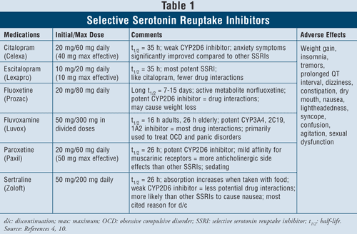
Adverse Effects
Interesting Points
  Fluoxetine, sertraline most activating
  Paroxetine, fluvoxamine most sedating
  Sexual dysfunction in up to 50%
  Possible increase in risk of bleeding

Slide 10
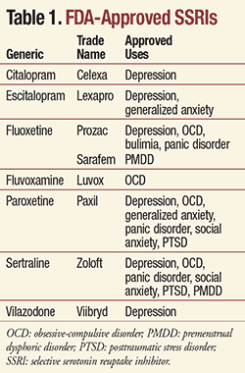
Multiple Indications

Slide 11
SNRIs(Serotonin/Norepinephrine Reuptake Inhibitors)
Works to increase both serotonin and norepinephrine available
Include
  Duloxetine(Cymbalta)-Also approved for neuropathy and other pain issue
  Venlafaxine(Effexor)
  Desvenlafaxine(Pristiq)
  Milnacipran- (Savella)-only approved for fibromyalgia
  Levomilnacipran(Fetzima)
General side effects similar to SSRIs
  Venlafaxine and Desvenlafaxine
Other Uses:
  GAD, Social Anxiety Disorder, PTSD, Incontinence

Slide 12
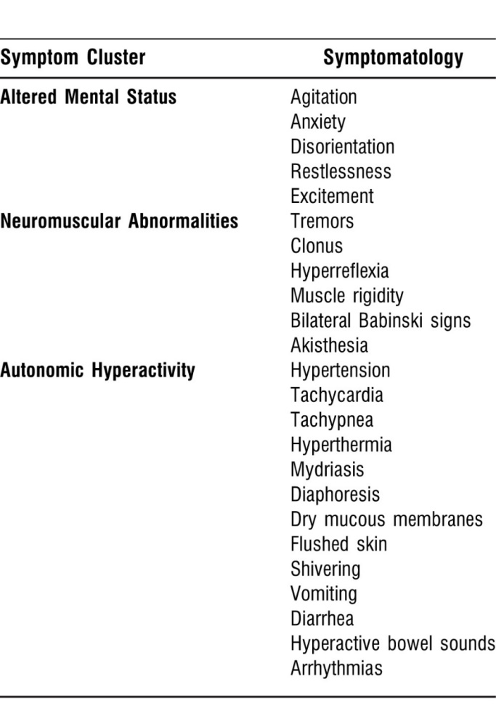
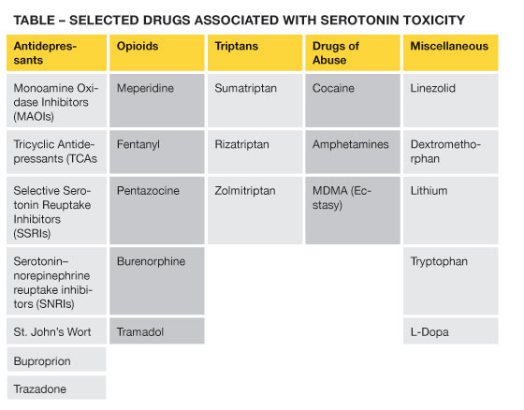
Serotonin Syndrome
Potentially life-threatening condition where the excess accumulation of serotonin results in severe side effects
  Can be with initiation of serotonergic medication
  Overdose of serotonergic med
  Use of combo of serotonergic activating drugs
Common Interacting Medications

Slide 13
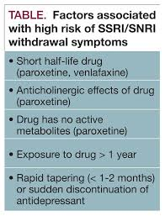
Withdrawal
Occurs when abruptly stopping chronic SSRI or SNRI
Always recommended to gradually taper patients off chronic SSRI
  2-4 weeks minimum
Signs/symptoms include:
  Flu-like symptoms
  Neurologic Symptoms
    Insomnia
    Anxiety
    “Electric Shock”
Can reinitiate SSRI if symptoms arise and begin dose taper again at a slower rate
Need to watch for in trazodone and bupropion

Slide 14
Bupropion
Works to increase dopamine and norepinephrine
Useful as add-on to SSRI therapy
Can be used to augment sexual dysfunction with SSRI
Increased risk of seizures (extended release less so)
Also rarely used for ADHD

Slide 15
Mixed and Miscellaneous Agents
Vilazodone-similar to SSRI
  Take with food, may cause nausea, diarrhea
  Lower incidence of sexual dysfunction
Vortioxetine-SSRI with other serotonergic activity
  Lower incidence of sexual dysfunction
Trazodone
  Causes dizziness and sedation (used a lot in insomnia)
  Watch for priapism
Mirtazapine
  Less sexual side effects
  Can be very sedating
  Increased appetite and weight gain

Slide 16
Tricyclic Antidepressants (TCAs)
Block serotonin and norepinephrine reuptake but different from SNRIs
Adverse effects limit use
Several off label uses
  Anxiety, pain, migraine prophylaxis
Adverse effects include dizziness, sedation and sexual dysfunction
Can be very toxic to heart in overdose
Can cause seizures as well
Don’t withdraw suddenly

Slide 17
Suicidality
All antidepressants have warning for increase in suicidal thinking
  Primarily children adolescents and adults <24 yo
  Risk highest at initiation and dose adjustment
  Watch for agitation and anxiety as other features
  All antidepressants have informational sheet given at dispensing and should be counseled on

Slide 18
Partial Responders or Treatment Resistant
Monitor for adherence, one of the biggest reasons for nonresponders
Can be switched to other agent in same class or switch classes
Can add on different class of medication
  Bupropion or mirtazapine to SSRI
Atypical Antipsychotics
  Aripiprazole, bezpiprazole, or quetiapine
  Olanzapine+Fluoxetine is approved for treatment resistant depression
Esketamine(intranasal or IV)
  Very new and adverse effects aplenty, patient needs to be monitored every time med is taken
  Fast onset

