Slide 1

rEASON PROJECT
Rural Emergent Alternative Surgical Opioid Non-use
Closing the Door on Surgery as a Gateway to Persistent Use of Opioids
Module 1: Curriculum Introduction
© 2021 Cornerstone Whole Healthcare Organization. All rights reserved.

Slide 2
about this course:
Goal: Educate stakeholders on the role of surgery as a gateway to persistent opioid use.
Means: Seven modules to promote understanding how and why surgery may lead to opioid use disorder.
Outcomes:
Providers will be able to educate patients about their options for surgical pain management.
Advocate for safe and effective opioid-free pain treatment and follow-up.
Achieve prevention of opioid use disorder.

Slide 3
01
Surgery as a Gateway to Persistent Opioid Use; Defining the problem
02
Opioids; From Friend to Foe
03
Opioid Induced Hyperalgesia
Curriculum Modules
Adolescents/Young Adults as a uniquely Susceptible Group
04
05
Multimodal analgesia; concept and implementation: Regional Anesthesia
06
Multimodal analgesia; concept and implementation: NSAIDs
Developing a Pain Management Plan: Responsible Follow-up& Transition of Care From Surgery
07

Slide 4
Introduction Module Objectives
Upon completion of this course, the learner will be able to:
Understand the problem of surgery as a gateway to persistent opioid use
Identify high risk patient populations and factors
Discuss the prevalence of opioid use disorder as a complication of surgery
Understand factors in opioid over-prescribing and how you can make a positive impact
Identify risk factors for post surgical persistent use of opioids
Discuss multimodal, multidisciplinary pain management

Slide 5
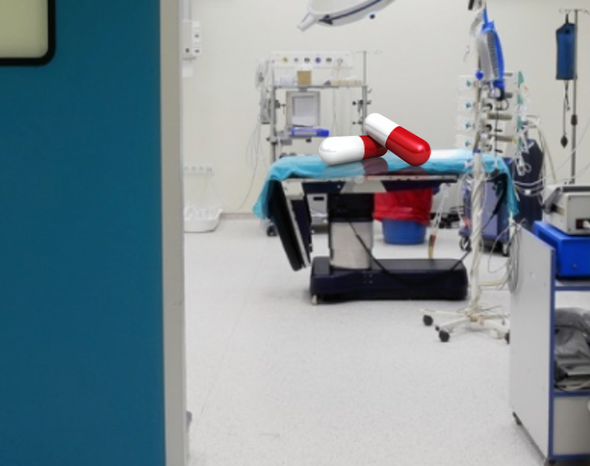
Surgery has been a long-ignored gateway to persistent opioid use, dependence and addiction

Slide 6
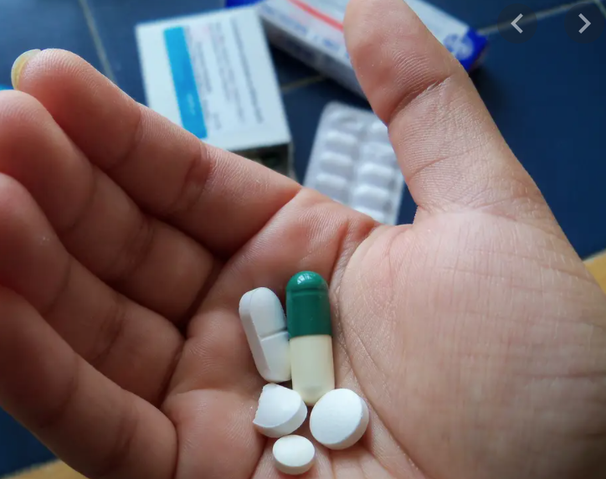
Fact: Opioid dependence is the most common complication of surgery in adolescents and adults
Focused efforts to educate and support stakeholders need to happen
Prevention is easier than treatment

Slide 7
Surgery as a Gateway to long term opioid mis-use; Defining the Problem:
Surgery is frequently the first-time patients are exposed to opioids
The role of opioids in treating postsurgical pain has been overlooked as a contributing factor to the opioid epidemic
Nearly 4.7-12% of surgical patients in 2017 continued to take opioids three to six months following surgery with as high as 17% for patients undergoing certain surgeries.
Clinicians treating surgical pain need the tools and resources to make evidence-based prescribing decisions that will adequately treat patients’ pain while minimizing opioid risks

Slide 8
Introduction: Surgery as a gateway to persistent opioid use;
Defining the problem
Module Overview
  Persistent opioid use is common after surgery
  Risk factors for persistent opioid use
    Age
    Gender
    Heredity/Environment
    Mental health status
  Overprescribing is well-documented

Slide 9
Why are opioids addictive?
1
3
Opioids trigger the release of endorphins, the brain's feel-good neurotransmitters.
When an opioid dose wears off, there is a desire to have those good feelings back, as soon as possible.
2
4
Endorphins muffle the perception of pain and boost feelings of pleasure, creating a temporary but powerful sense of well-being.
This is the first milestone on the path toward potential addiction.

Slide 10

Risk Factors
Younger Age
Female Gender
Millennials
Heredity/Environment & Mental Health Status
  Heavy tobacco use
  History of depression or anxiety
  Stressful circumstances
  Poverty/Unemployment
Exposing Patients Longer and to Higher Quantities of Opioids than Necessary
Notes:
Why talk about this with the PCP? They have the RELATIONSHIP WITH THE PATIENTS! And can empower the patients to ask the RIGHT QUESTIONS of the surgeon and anesthesiologist.

Slide 11
Women
Postsurgical opioid treatments pose the greatest risk to women
Women are 40% more likely than men to become newly persistent users of opioids following surgery.
While 11.3% of women continued to use opioids three to six months after surgery in 2017, just 8.1% of men became long-term users.
Among persistent users, women were prescribed 15% more opioids than men.

Slide 12
Millennials
Prescription opioid abuse is more common among Millennials than any generation before.
8% of Boomers and Gen Xers abused painkillers in the past year
Over 12% of Millennials report recent painkiller abuse.
More millennial women become persistent opioid users than men

Slide 13
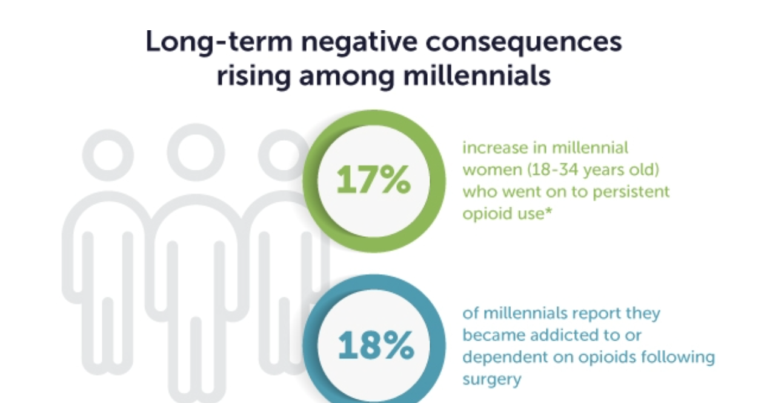

Slide 14
Teenager and Young Adults are Particularly Vulnerable to Substance Abuse Disorders
Opioid exposure at a young age increases the risk for development of substance use disorder
Teenage brains lack mature connections between amygdala (emotion center) and frontal cortex (maturity, self-control & decision-making).
Addiction is a type of learning & teenage brains are programmed for rapid learning
Younger users find drugs more rewarding due to increased number of dopamine receptors
Dopamine increases reinforce behaviors that elicit reward

Slide 15
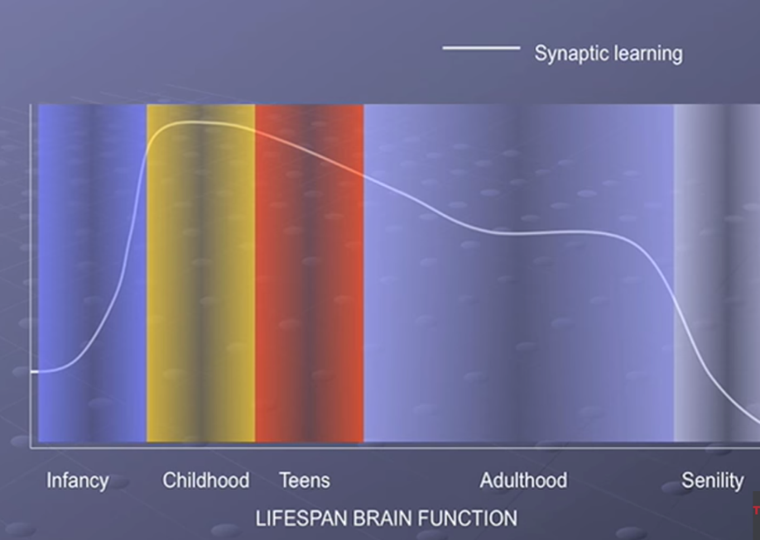

Slide 16
Opioids to Treat Postsurgical Pain are Overprescribed
In 2017, surgery patients were prescribed from 45 - 200 pills to treat pain from 7 common procedures
Nearly two-thirds of surgeons report feeling pressure to prescribe more opioids than they think is necessary to treat their patients’ pain.

Slide 17
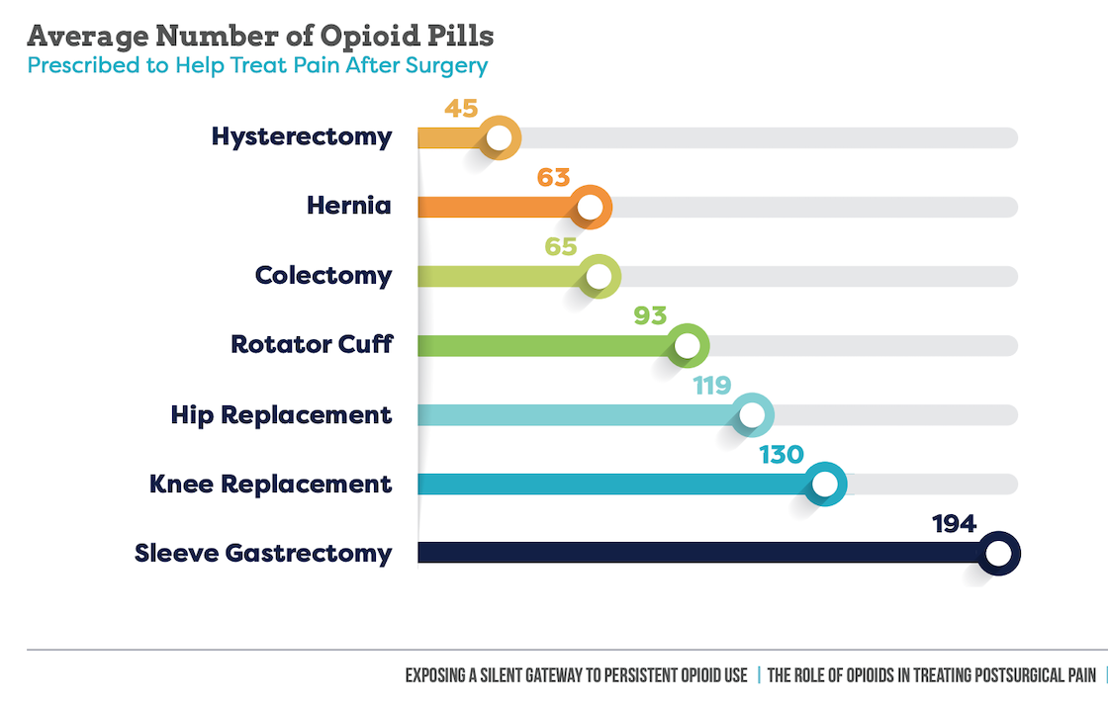
Patients across 7 surgical procedures were each prescribed 82 opioid pills (average) for postsurgical pain in 2017
(slight drop from 85 pills in 2016)

Slide 18
The length of time prescribed opioids are used is critical.
Opioids are safest when used for three or fewer days to manage acute pain
The odds of continued opioid use at one year after starting a short course increase after five days on opioids.
CDC 2018: Characteristics of Initial Prescription Episodes and Likelihood of Long-Term Opioid Use -2006-2015
MMWR 2017;66(10):265-269

Slide 19
Lack of Prescribing guidelines
Because pain is such an individual experience, it is difficult to standardize its assessment and treatment from patient to patient and across varying procedures, there has been a reluctance to provide specific guidance with respect to opioid prescribing.
Surgeons are left on their own to determine the appropriate quantity and strength of opioids for their patients’ pain.
The absence of clear guidelines has led to tremendous variation in prescribing patterns and a great deal of overprescribing that can lead to persistent opioid use, addiction and dependence among patients, as well as unused pills that can be misused or abused by others.

Slide 20
Unused Opioids Threaten Families and Communities
Surgical patients refill opioid prescriptions even though they no longer needed the drug to manage pain. Instead, they want them just in case they or their family or friends need them in the future or because they are addicted or dependent.
Overprescribing opioids not only puts patients at risk, but also those around them.
Of the people who misused opioids in 2017, 97% used prescription opioids and more than half obtained them from a friend or relative.
Almost 90% of patients with leftover opioid pills didn’t properly dispose of them, with many keeping them in their homes and some sharing them with family or friends.
Nearly half of 40-54-year-old patients with leftover pills kept them in their home. This is an age group that typically has teenage children – one of the most at-risk groups for misusing or abusing opioids.

Slide 21
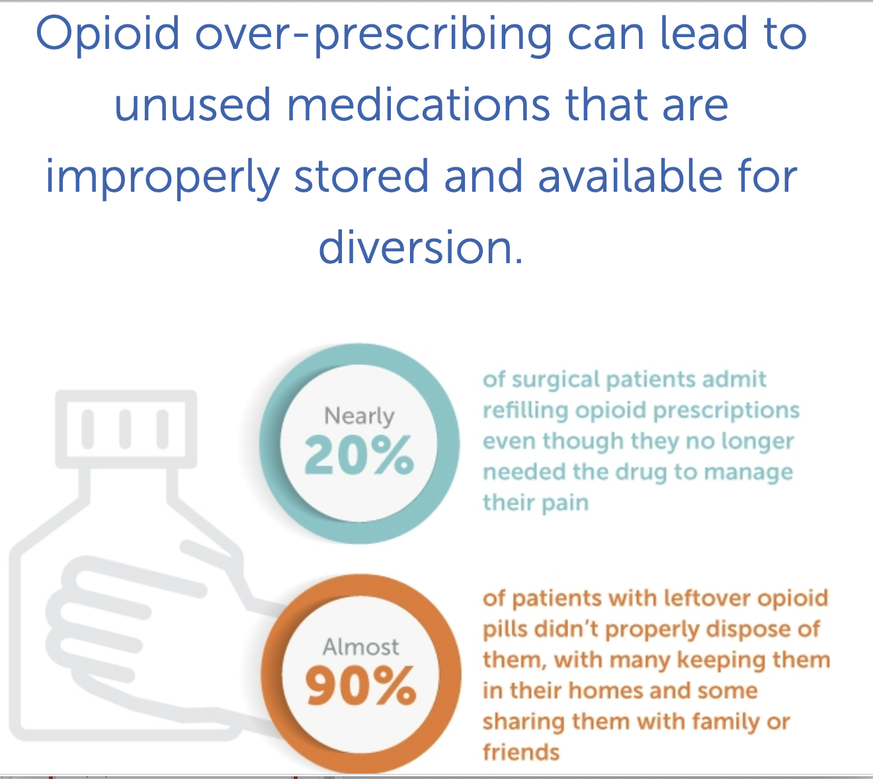

Slide 22
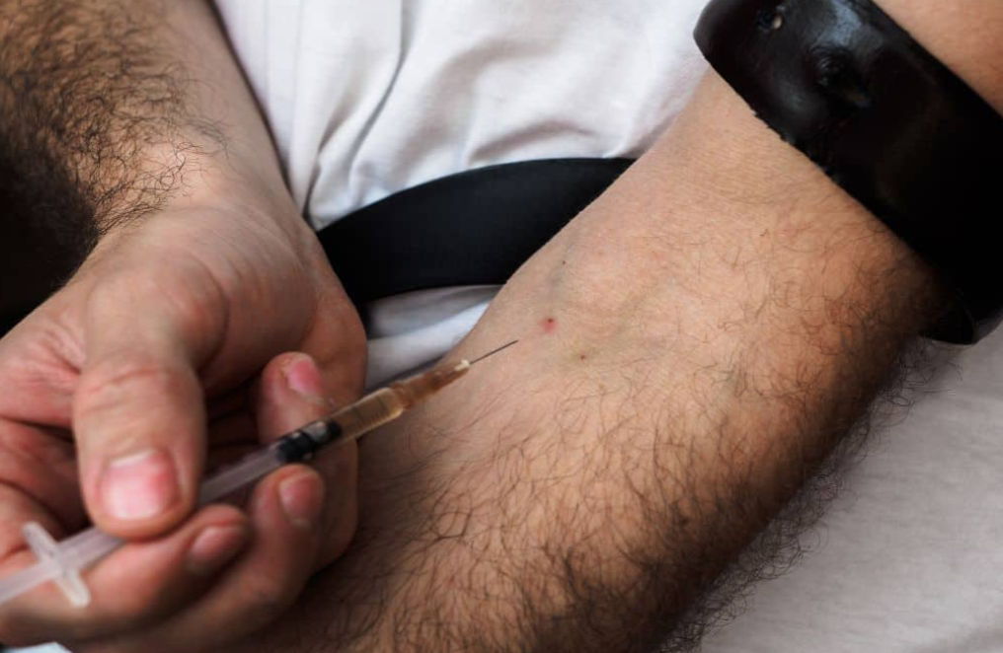
Myth: Limiting access to prescription opioids leads to use of street drugs
Fact: Reducing the number of opioid pills for patients with chronic pain can lead to a greater number of overdose deaths from illicit opioid use over time.
Fact: Reducing prescription opioids for acute pain prevents overdose deaths over time.

Slide 23
But isn’t something being done?
A number of federal and state regulations, payer reimbursement controls and medical guidelines have been put in place to restrict amounts & duration of opioids prescribed.
In spite of these initiatives, the progress to reduce prescribing varies widely geographically and demographically, with overprescribing of opioids still posing a serious risk to many vulnerable populations.
Opioid prescriptions only decreased 10% from 2016-2017

Slide 24
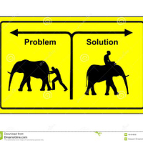
Potential Solutions
Clinicians: Assess patient risk when prescribing opioids for surgery patients and provide alternatives to opioid, especially in high-risk populations.
Patients and their caregivers: Understand risks and options and advocate for non-opioid and opioid-sparing treatment of their post surgical pain.

Slide 25

Multidisciplinary Pain Management Planning

Slide 26
Reduce or eliminate the need for opioids to treat pain during & after surgery
Multimodal pain management utilizing non-opioid options
  non-steroidal anti-inflammatory drugs (NSAIDs),
  acetaminophen
  local anesthetics
  non-drug methods
    Supplements
    Massage
    Heat/cold
    M-Stim

Slide 27
Evidence –based Prescribing
Limited number of opioids
Limited number of days
Transition to non-opioid medications within 3-4 days for those patients prescribed opioids
Follow-up & transition of care for those patients requesting opioid refills after 5 days

Slide 28
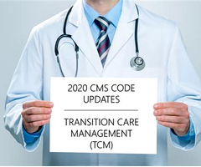
Responsible Transition for Care of Postoperative Patients Using Opioids

Slide 29

DISCUSSION
POINTS:
HOW CAN WE USE THIS RISK FACTOR KNOWLEDGE TO IMPROVE CARE OF OUR PATIENTS AND OUR COMMUNITY?
WHAT RISK FACTORS ARE WITHIN YOUR CONTROL?
WHY TALK WITH PRIMARY CARE ABOUT THE PERIOPERATIVE PROCESS?
Notes:
Exposing Patients Longer and to Higher Quantities of Opioids than Necessary; PERIOPERATIVE
Why talk about this with the PCP? They have the RELATIONSHIP WITH THE PATIENTS! And can empower the patients to ask the RIGHT QUESTIONS of the surgeon and anesthesiologist.

Slide 30
Review Questions:
T / F Persistent use of opioids following surgery is a real risk for opioid naïve patients.
T / F Opioid dependence is the most common complication of surgery.
T / F Women are more likely than men to become new persistent users of opioids following surgery.
T / F Adolescents are at high risk of developing persistent use of opioids because their brains lack mature connections in those areas associated with self-control and decision-making.
T / F Limiting access to post-surgical prescription opioids in opioid-naïve patients leads to use of street drugs.
T / F The odds of continued opioid use at one year increases dramatically after 5 days on opioids.
T / F Patients and their caregivers need to understand and advocate for non-opioid alternatives to surgery and opioid sparing treatment options for their post surgical pain.
T / F Millennial women are more at risk for persistent opioid use compared to men that age.
T / F More than half of people who misused opioids in 2017 obtained them from a friend or relative.
T / F Limited number of opioids for a limited number of days, transition to non-opioid alternatives within 3 – 4 days and responsible follow-up and transition of Care can effectively reduce the odds for surgically gated persistent use of opioids.
Answer Key: 1 – 4: True, 5: False, 6-10: True

